Slide 1
How to Use HB1027 & A National Legislative Update
Joe Doherty
jdoherty@selfstorage.org

Slide 3
We Like You Just the Way You Are
No change to the timing of the sale (minimum of 46 days in default).
No change to the content of the advertisement (tenant’s name is not required).
No required changes to the default notice or rental agreement.
No change to the timing of the advertisement (at least 7 days before the sale).

Slide 4
Goodbye to the Newspapers
Advertising is still required, but newspaper advertising is now optional.
Instead, operators can advertise in a “commercially reasonable manner.”
As with newspaper advertising, you can charge tenants for other forms of advertisement.

Slide 5
Commercially Reasonable Manner?
Two considerations when deciding whether advertising is done in a commercially reasonable manner:
At least three independent bidders participate in the sale of the personal property; and
The manner is in conformity with advertising practices among dealers in the type of personal property being sold.

Slide 6
“Independent Bidder.” Neither Independent Nor a Bidder. Discuss.
Arkansas defines “independent bidder” differently from other states.
No requirement that each bidder is “independent” from the facility owner or other bidders.
Also, no requirement that an independent “bidder” is even a bidder.
Instead, independent bidder includes anyone who (1) makes an offer in-person or online; (2) is physically present at the sale; or (3) views the sale online.

Slide 7
Don’t Stand Out from the Crowd

Slide 8
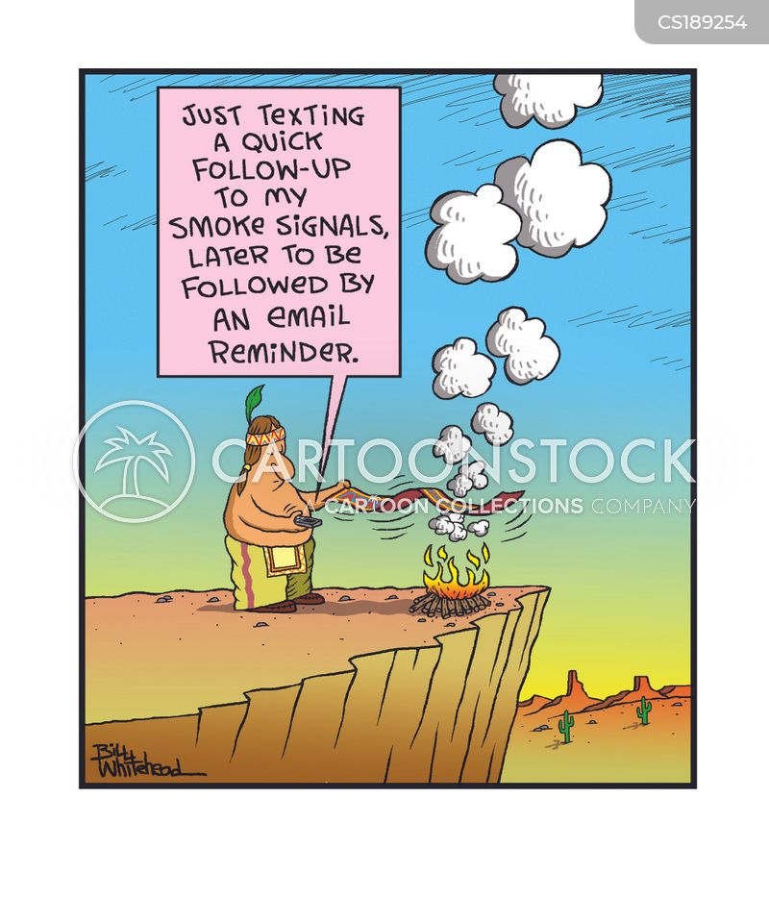
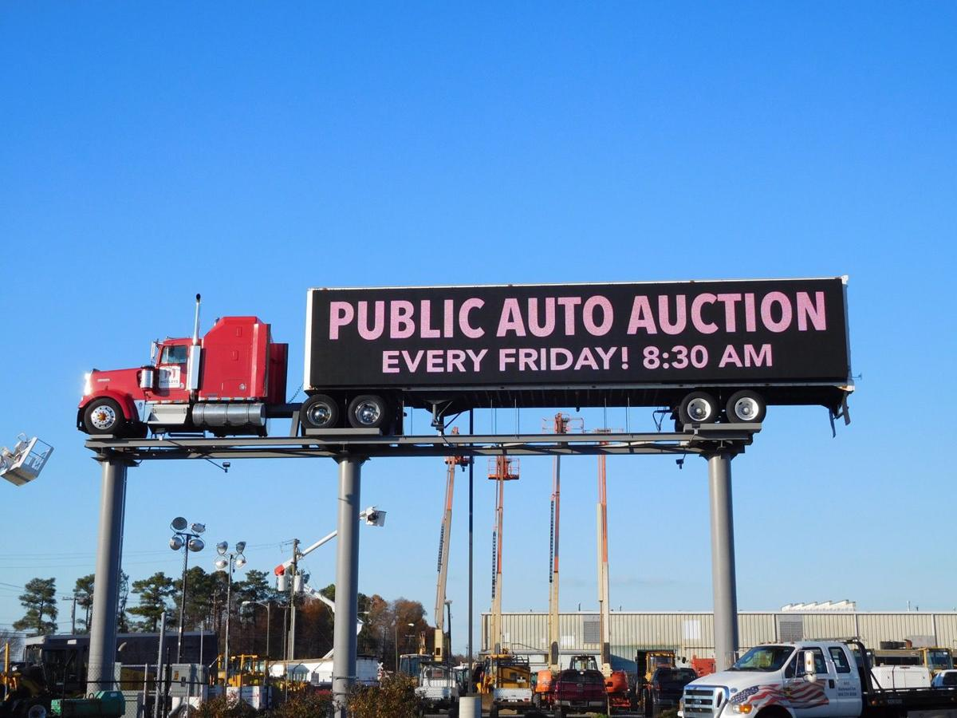
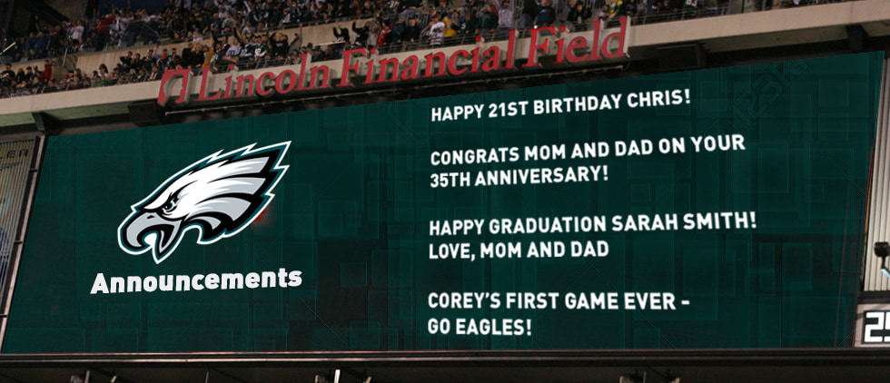
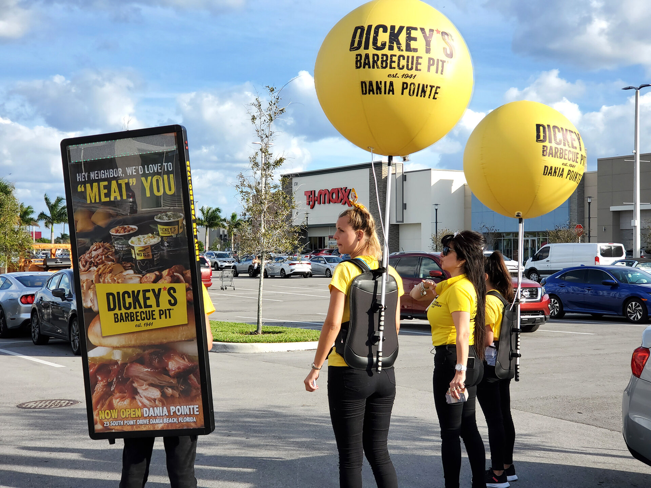
How Not to Advertise Lien Sales

Slide 9
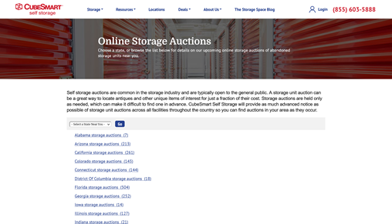
Options for Advertising Lien Sales

Slide 10
Examples of Advertisements
In accordance with Act 576 of the state of Arkansas passed in 1987, BILL’S SELF STORAGE intends to hold a public sale on Saturday, August 28th, 2021 at the times and locations listed. The contents of the following units with corresponding lessee will be the subject of the sales: Bill’s Self Storage, 123 Hillary Clinton Blvd., Little Rock, AR 72210 August 28th @ 10 a.m. #534 #606 #731 #735 The contents of these spaces are subject to an operator’s lien for delinquent rent and additional charges incurred which will become due in full on August 28th, 2021. Unless the delinquent charges are paid in full before August 28th, 2021 at 10:00am, the contents of the mentioned units will be sold. The sale will begin at 10:00 a.m. on the premises of Bill’s Self Storage, 123 Hillary Clinton Blvd., Little Rock, AR 72210 Terms of the sale shall be cash only. 501-867-5309
NOTICE OF PUBLIC SALE In accordance with Ark. Code Ann. § 18-16-401 through § 18-16-413, and pursuant to the rental agreements between Hillary’s Self Storage and the following tenants occupying Storage space numbers: 1104 Bill Clinton 1112 Johnny Cash 1151 Scottie Pippen The property securing the above-named Tenant's obligations to U-Storit, Inc., will be sold online at www.StorageLienSale.com with bidding starting on Monday, August 16th, 2021 at 10:00am and ending on Wednesday, August 18th, 2021 at 10:00 am at which time the high bidder will be selected and the property sold. The location of the facility is 456 Hot Springs Rd., Little Rock, AR, 72204, telephone (501) 555-5555. The property to be sold consists of numerous types of household goods, and other items of personal property including furniture, housewares, recreational goods, tools, appliances, and clothing. The sale shall be in parcels, each parcel being the contents of a storage unit. The collateral being sold and sale terms may be viewed at www.StorageLienSale.com. This sale may be withdrawn at any time without notice. Certain terms and conditions apply.

Slide 11
SSA Pushes Property Tax Reform
Indiana passed a bill earlier this year limiting property tax assessments to the lowest amount derived from the three common assessment methods.
The bill also requires that assessors exclude business intangible value.
Similar bill was vetoed in Idaho.
SSA successfully opposed sales taxes in Nebraska and Virginia.
Is the Indiana legislation necessary in Arkansas?
Federal legislation coming?

Slide 12
Licensing for Self Storage. What’s the Harm?

Slide 13
Blame Self Storage for Illegal Dumping

Slide 14
The Right to Keep Arms, In Self Storage

Slide 15
Changes to the Model Building Codes
An exception has been added to IBC Section 2902.3.3 to permit an increase in the location (to greater than every other floor) and maximum distance of travel (to greater than 500 ft) for restrooms. The location and travel distance must be approved by the code official.
The maximum allowable height of sprinklered facilities made of Type IIB materials (unprotected steel) and Type IIIB materials (noncombustible or fire-retardant-treated wood stud exterior walls and any interior construction) has been increased from 3 stories to 4 stories. The Code continues to have total floor and building square footage limits.
Pursuant to modified IBC Section 903.2.9, storage facilities are exempt from the automatic sprinkler system requirement if: (1) the total fire area is 12,000 sq. ft. or less; (2) the combined total fire areas are 24,000 sq. ft. or less; (3) the facility is no greater than one story above grade plane; and (4) all storage spaces are accessed directly from the exterior.
More recent changes relating to interior lighting for units accessible from the exterior and how to determine occupiable square feet for fresh air intake requirements.

Slide 17
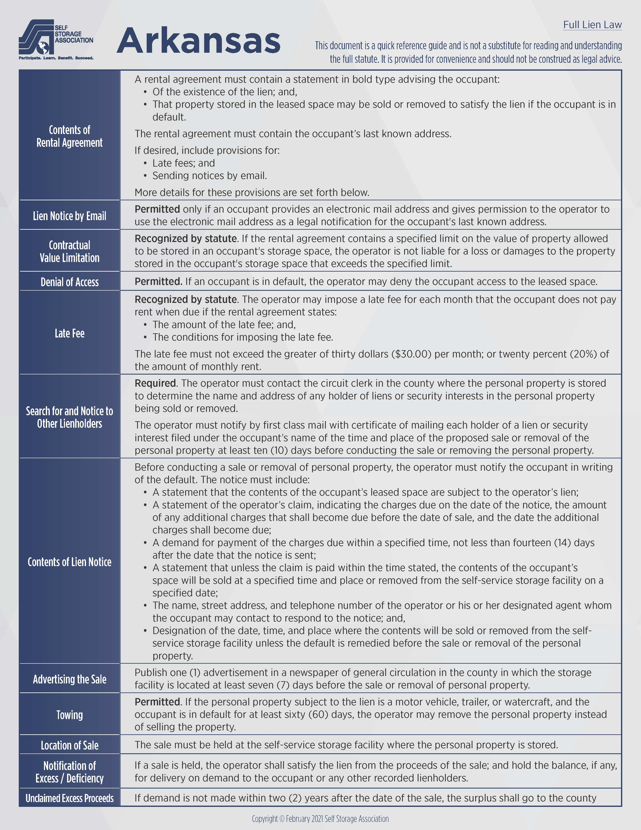
Want to Learn More?
Purchase at selfstorage.org. Also available in bulk to the ARSSA.
Joe Doherty
jdoherty@selfstorage.org

