Slide 1





10+10=100
Managers Workshop
Arkansas
M. Anne Ballard
President of Marketing, Training, and Developmental Services

Slide 2


Management Metrics
Metrics: a method of measuring something, or the results obtained from this

Slide 3
10 Management Metrics That Spell Success
1- Same Store Sales Increase
2-NOI Increase
3-Gross Potential & Street Rates
10-Economic Occupancy & Customer Rates
6-Discount %
5-Box Sales Per Lease
4-Insurance Sales
7-Fees Waived %
8-Delinquent %
9-Expense %

Slide 4
10 Marketing Metrics That Spell Success
Session 2 Thursday the 24th.
1-Conversion
Calls-Walk Ins- Leases
2-Phone Shop Scores
3-Cost Per Lease
10- Source % DB, INT,
RREM, ADS, and Other
6-Marketing Visits #
5-Email # Sent & Open Rate
4-Web / Smartphone %
7-Referrals #
8-Online Visitor & Reservations #
9-Net Gain Rentals

Slide 5

2022 Almanac Updates
50,523 Total Facilities (+1290)
        39,945 Average SF per store
        2.018 Billion total net s.f.
        6.20 Avg. S. F. per person
        All Rates Are Thru Q2
        $111.67 - National Avg. 10 x 10 Rental Rate
        $113.02 - South Avg. 10 x 10 Rate
        $146.72 - National Avg. Climate 10 x 10
        $140.35 - South Avg. Climate 10x10
        All rates were up 10% +
National Rates PSF 5x5 5x10 10x10 10x15 10x20
Climate $2.32 $1.71 $1.33 $1.16 $1.14
Non-Climate $1.99 $1.37 $1.10 $0.91 $0.84
manneballard@aol.com Universal Storage Group 770-801-1888
5

Slide 6
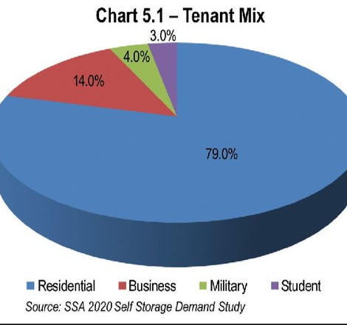
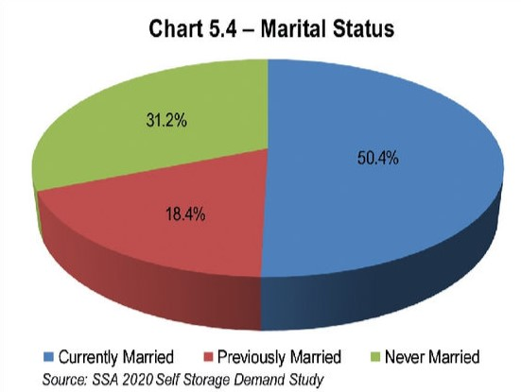
2022 Self Storage Almanac
6
manneballard@aol.com Universal Storage Group 770-801-1888

Slide 7
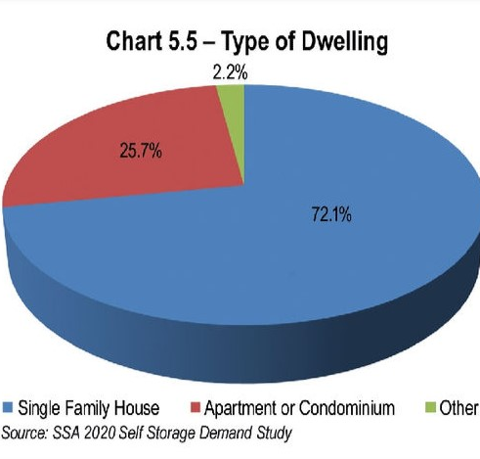
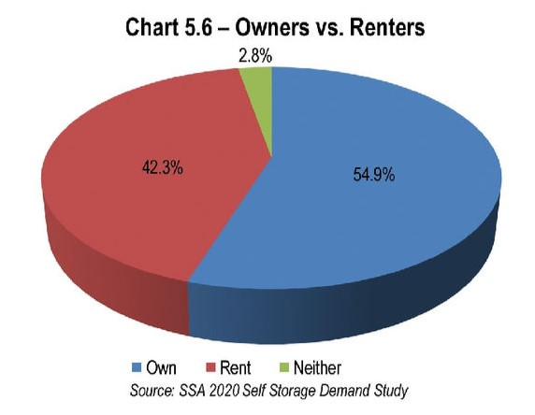
2022 Self Storage Almanac
7
manneballard@aol.com Universal Storage Group 770-801-1888

Slide 11
10 Management Metrics
Same Store Sales Increase
NOI Increase
Gross Potential & Street Rates
Economic Occupancy & Customer Rates
Discount %
Box Sales Per Lease
Insurance Sales
Fees Waived %
Delinquent %
Expense %

Slide 12
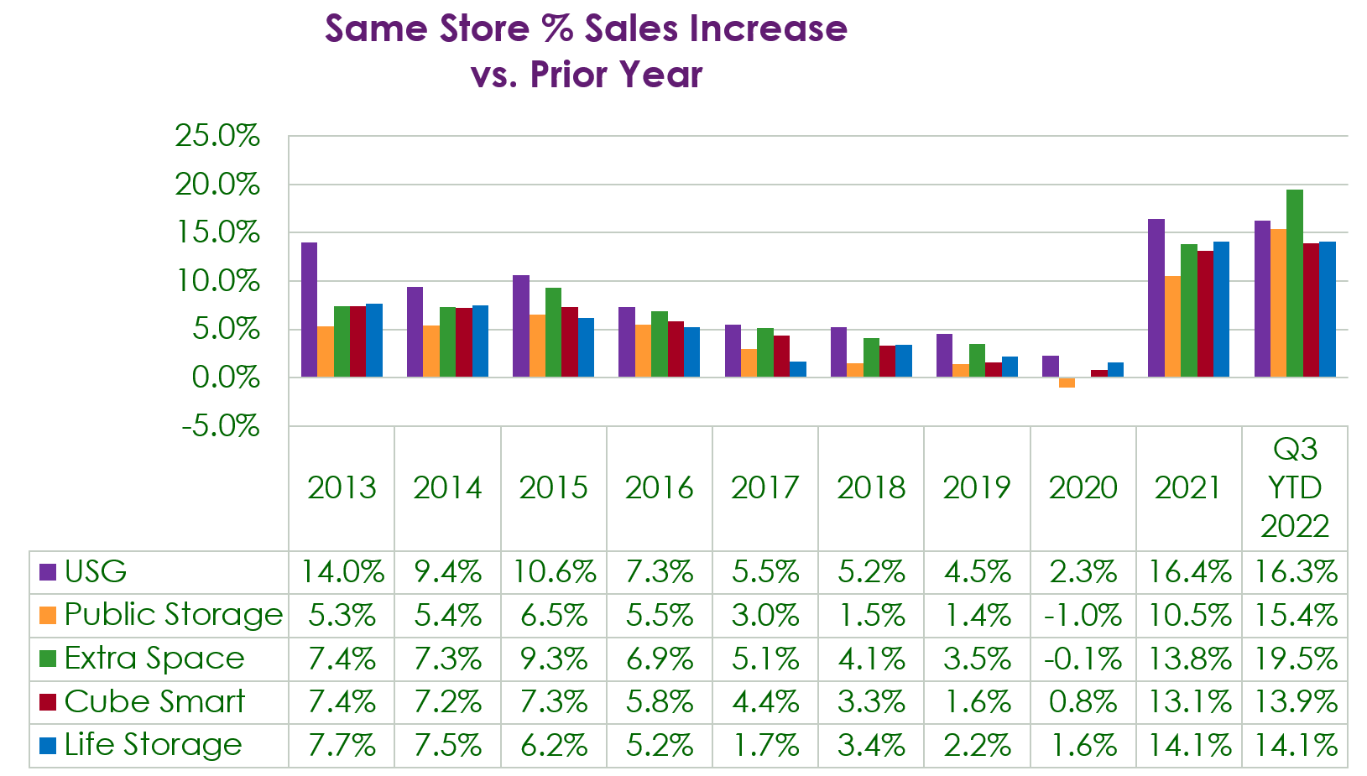
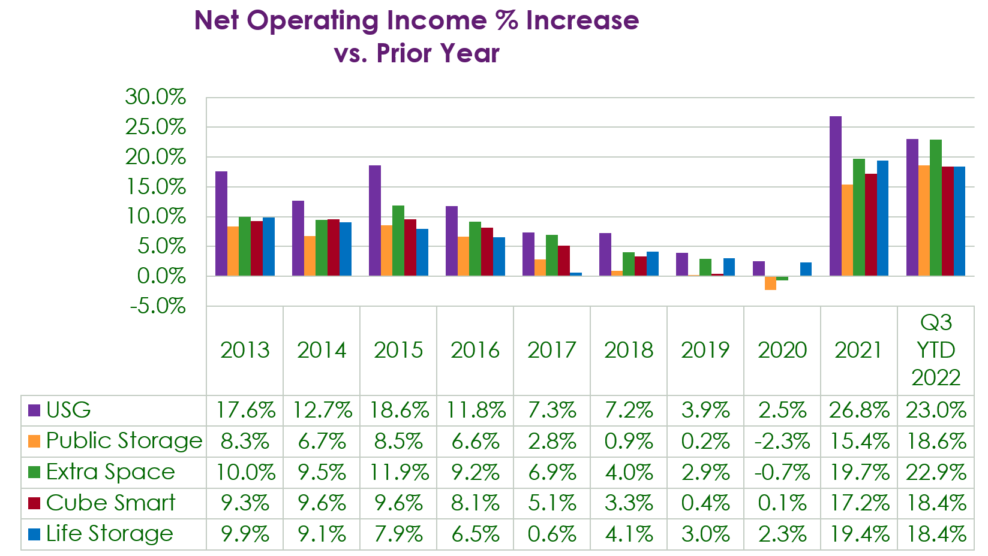
Management Metrics

Slide 13

Management Metrics
Same Store Sales Increase - SSSI
Measuring the Income Change vs. The Same Period a Year Ago.
Compare to the REIT’s Every Quarter.
If 2022 Income was $1.5 million and 2021 Income was $1.2 Million Then the SSSI was 25% or 1,500,000 ÷ 1,200,000 = 1.25 or 25% increase

Slide 14
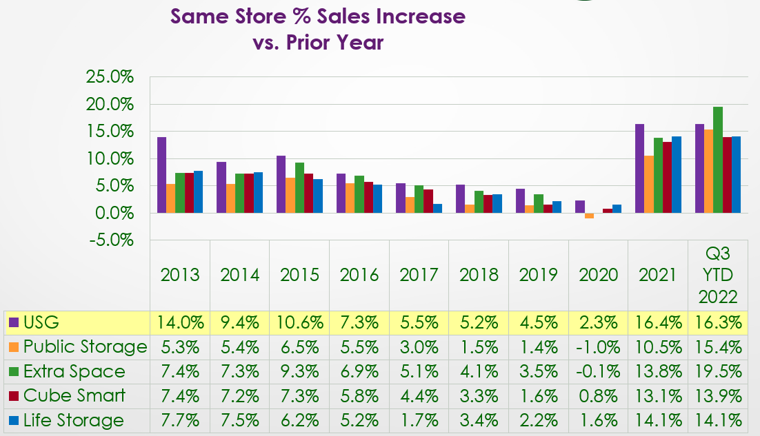
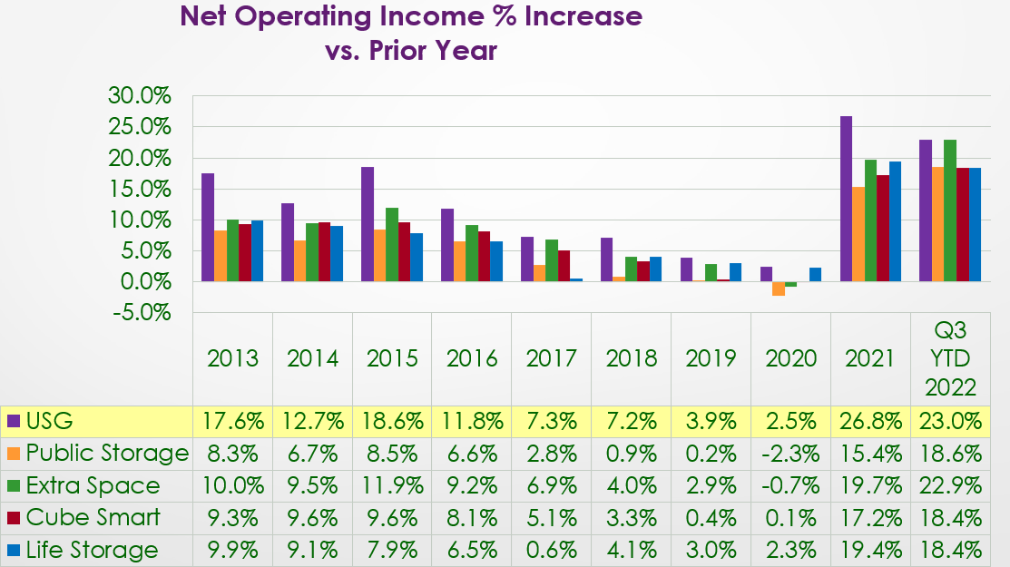
Management Metrics
Same Store Sales Increase / NOI
Measure at Least Annually but anytime.
Get Last year’s Management Summary and the year before, then divide the total income last year by the income year before= SSSI

Slide 15
Management Metrics
Same Store NOI Increase

Slide 16

Management Metrics
Same Store NOI Increase
Measure at Least Annually but anytime.
Get Last year’s Cash Flow Statement and the year before, then divide the total Net Operating income last year by the net operating income year before= NOI increase

Slide 17
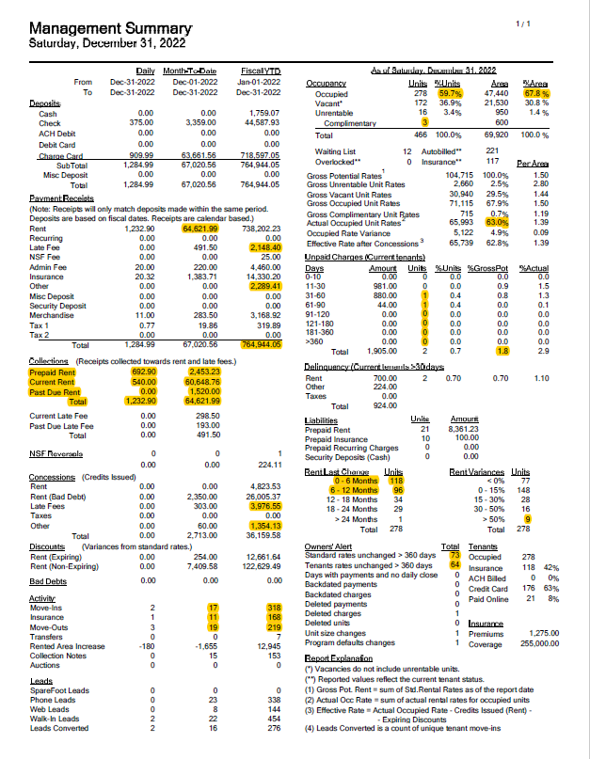
Your Management Summary
8 of 10
Key Metrics For Success

Slide 18
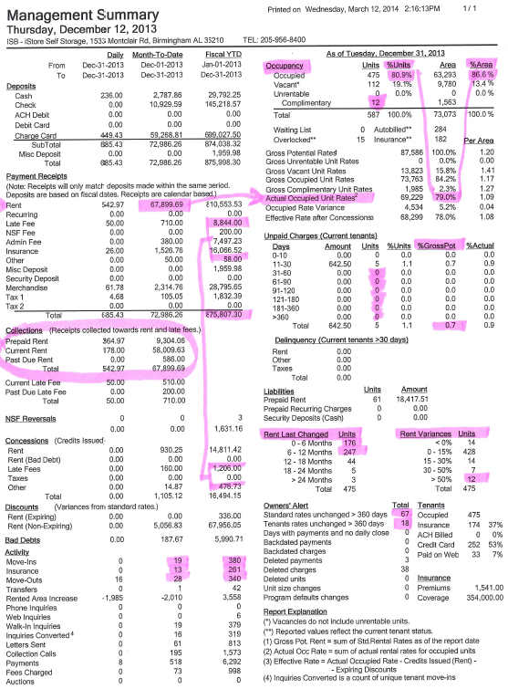
3 Types Of Occ.
In Balance, Which Is Largest Number?
Rent Collected = Contract Totals?
Delinquency,
No 60-90 Day Money
Less Than 5% GP
Late Fees + Other Collected Divided By Fees + Other Waived, Want Less Than 10%
Add 0-6 & 6-12 = Total Occ.?
Is # Over 50% Disc. = To Total Complimentary?
Net Gain/Loss On Move Ins; 90% Sold Insurance, MTD & YTD?
#’s Vs. Last Year?
Street Or Customer Rates Not Increased In 1 Yr+?
manneballard@aol.com
Universal Storage Group
770-801-1888

Slide 19
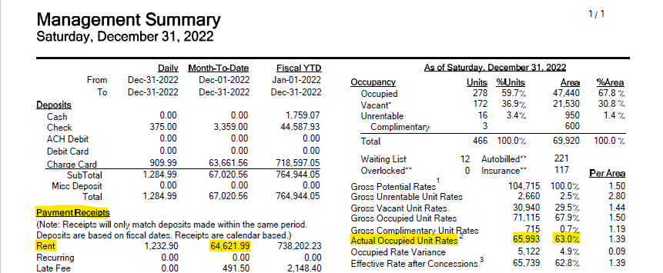
Management Summary
Rent Collected
Do your Rents Collected = Your Contract Totals?

Slide 20
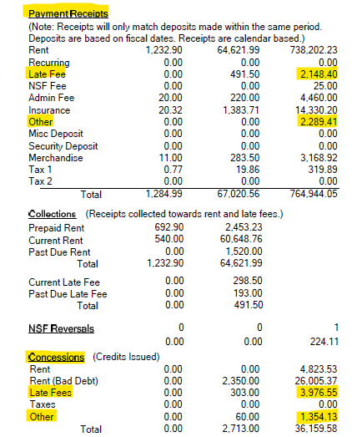
Management Summary
Late Fees and Concessions
Late Fees +
Other Collected
Here $4437
Waived ÷ Collected
Fees + Other Waived,
Should Be Less Than 10%
Here $5330 = 120%!!

Slide 21
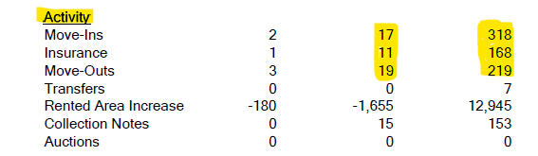
Management Summary
Activity
Net Gain / Loss YTD +99
90% Insurance Sold YTD 52.8%
Month to Date & Year to Date?
Numbers vs. Last Year

Slide 22
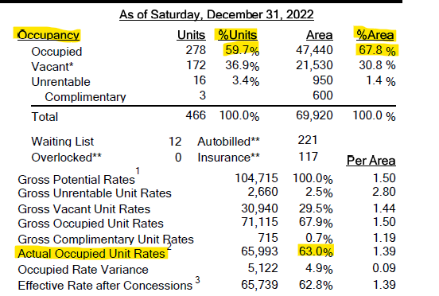
Management Summary
Three Types of Occupancy
Are Your 3 Types of Occupancy in Balance?
Which Number is the Largest?

Slide 23
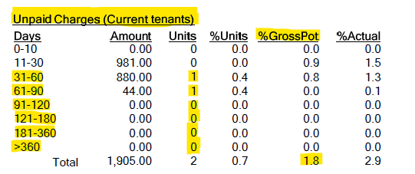
Management Summary
Delinquency
No 60-90 Day + Money
Should Be Less Than3 - 5% of Gross Potential
Process 30 day Past Dues Every Month

Slide 24
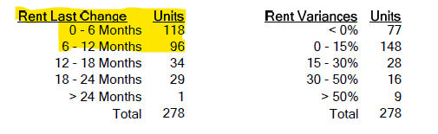
Management Summary
Customer Rate Increases
Add 0-6 & 6-12 = 214
Does That Number Equal Your Total Occupancy? Here there are 64 Without An Annual Increase? Why?
Those getting more than 50% discount should equal the total Company or Complimentary Spaces

Slide 25
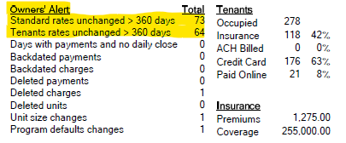
Management Summary
Street and Customer Rates
Street or Customer Rates not Increased in Over a Year?

Slide 26
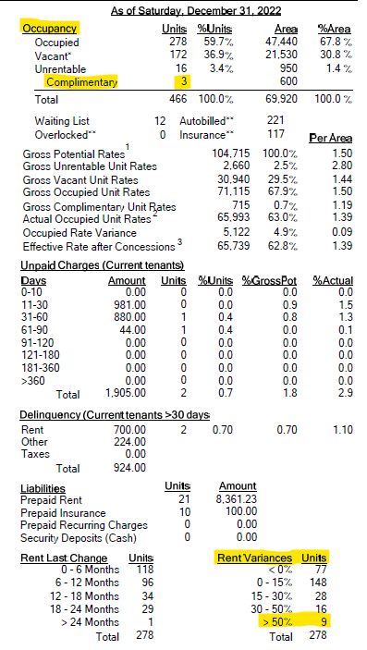
Management Summary
Complimentary Units
Is Your Total # of Complimentary Units
Equal To
Number Over 50% Discounted

Slide 27
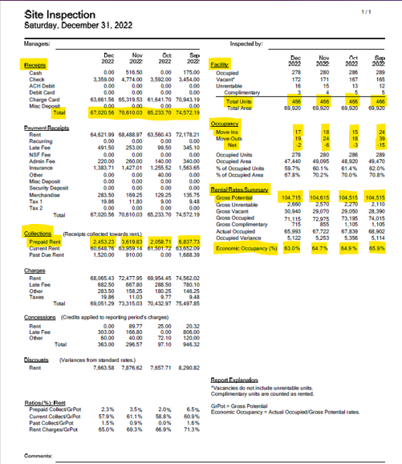
Site Inspection Report
4 months at a glance of the key numbers

Slide 28
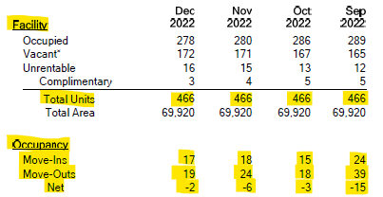
Site Inspection Report Unit Counts
Have the Number of Units Changed
Ins / Outs / Complimentary Look Correct

Slide 29
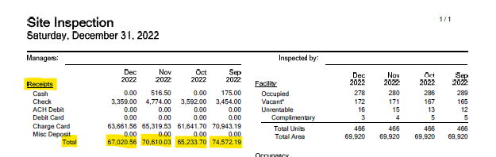
Site Inspection Report Monthly Totals
Are Your Monthly Totals Correct, Units The Same, SF the same, if you use Unrentable it will change your Occ/Vac percentages, use Unit Notes Instead!

Slide 30

Site Inspection Report Gross Potential
If You Are Doing Your Rate Increases, Both Standard and Customer Rates, Your Gross Potential Should Be Growing Each Month

Slide 31

Site Inspection Report
Prepaid Rent
Use Your Prepaid Rents To Reach Goals But Not More Than 50% of GP in December each year.

Slide 32
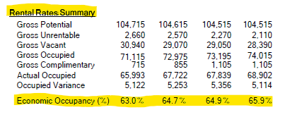
Site Inspection Report
Economic Occupancy
Key Occupancy Statistics for the Last 4 Months

Slide 33


2022 USG Store Averages
Average Store size in 2022 was 65,233 Net Rentable SF
2022 average unit size was 126 s.f. and average units per site was 511.
2022 Average Gross Possible Income of $14.57 psf/yr or $1.214 psf/month
Box Sales Per Lease 2020 was $18. 23
USG Portfolio Same Store Sales Increases, YoY 36
  Actual Occupied Unit Rates up 5.57% - Economic Occupancy
  Unit Occupancy -4.1% to 87.8%
  Total Insurance Sales +5.61%
  Total Payments + 13.04%
  Gross Potential Rates + 8.16%
  Gross Occupied Rates + 3.32%
manneballard@aol.com Universal Storage Group 770-801-1888
33

Slide 34
manneballard@aol.com Universal Storage Group 770-801-1888
34

Slide 35

manneballard@aol.com Universal Storage Group 770-801-1888
35

Slide 36
36
manneballard@aol.com Universal Storage Group 770-801-1888

Slide 38
Rate Management
  1) Standard or Street Rates
  Standard Rates (90% Occupancy By Unit Type Or 3 Or Less Available)
  2) Customer Rates
  Customer Rates (270 Days The Same Rate) Need 12% Over Current Rental Rate
  The Middle Of EVERY MONTH Is the Easiest
        At Any Given Opportunity
        Down To The Last One Of A Kind
        When Your “Spidey Sense” Tells You
        When You Have An Exclusive

Slide 39
Standard ( Street ) Rate Increases
Using the Occupancy Statistics or Rental Activity Report
See which unit sizes are 90% or higher and which have three or fewer remaining in available inventory.
Even though your competitors are potentially charging less than you on any given size, the demand for the unit at your facility is the only thing that matters.
High Demand = Raise Rent
The Market Price Leader Has The Highest Occupancy

Slide 40
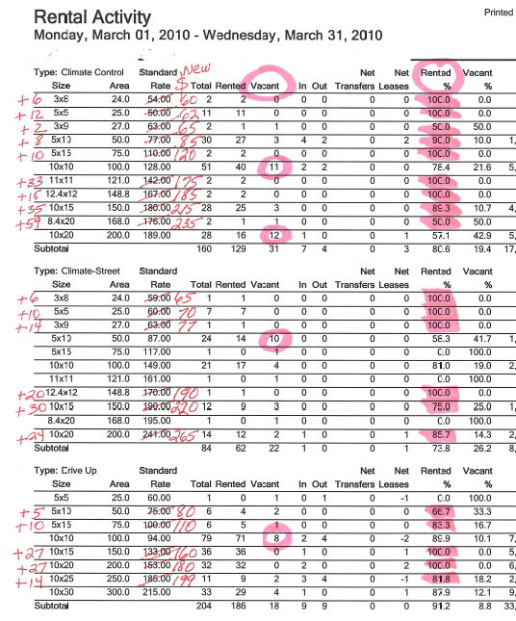
Street or Standard Rates
Rental Activity Report SiteLink
Leave Sizes With Lots Of Vacancy At The Current Price And Raise Prices Of Full Sizes Above And Below, This Creates A Perceived Discount.
Find All Sizes 90% + Occupied & Raise Price
Pearls of Wisdom Tour Universal Storage Group 770-801-1888
40

Slide 41
How Do We Create a Perceived Discount
Don’t Lower The Price On The Ones Available; Create A Perceived Discount Instead.
Raise Prices On Sizes Full Above & Below What’s Vacant.
Create A Large Bump From the Vacant Size To the Next Size Up, And Little Difference Between the Vacant Size And the Next One Down Or Smaller.

Slide 42
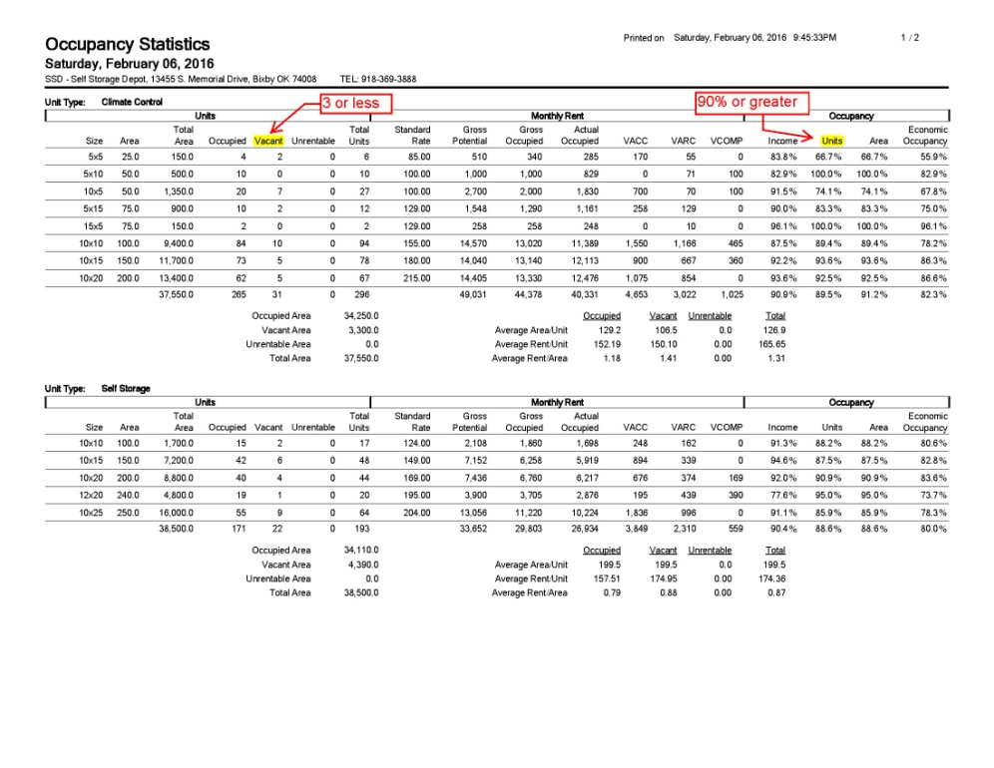
How Do We Create a Perceived Discount
Only One Size won’t be raised; all others qualify for increases.
Which One On This List Needs A Perceived Discount To Rent It Up?
Answer: 7- 10x5’s which are the only code not full.
If 5x5’s were $95; 5x10’s were $115 and 5x15’s were $139, 10x10’s were $170. Then you have created a perceived discount.

Slide 43
Customer Rate Increases
Using the Occupied Units Report sorted by Days Rate Unchanged
Find customers whose rent is 270 days or more at the same rate
Find Prepays And Make Sure They Get More Than 30 Days Notice, 90 Ok, Give RIL The Month After They Prepay or At Time of Prepay.
Move-In Specials- Give RIL At Move-In.
Auction Customers- Need Your Lease To Say They Will Go To Standard Rate If Past Due For 30 Days. Loss of Discount Clause
Charge For The Privilege- Bothersome Customers, Auction Customers, Special Locations, Special Features Like Power, etc.
Rate Increases Should Be At Least 12% Over The Rental Rate.

Slide 44
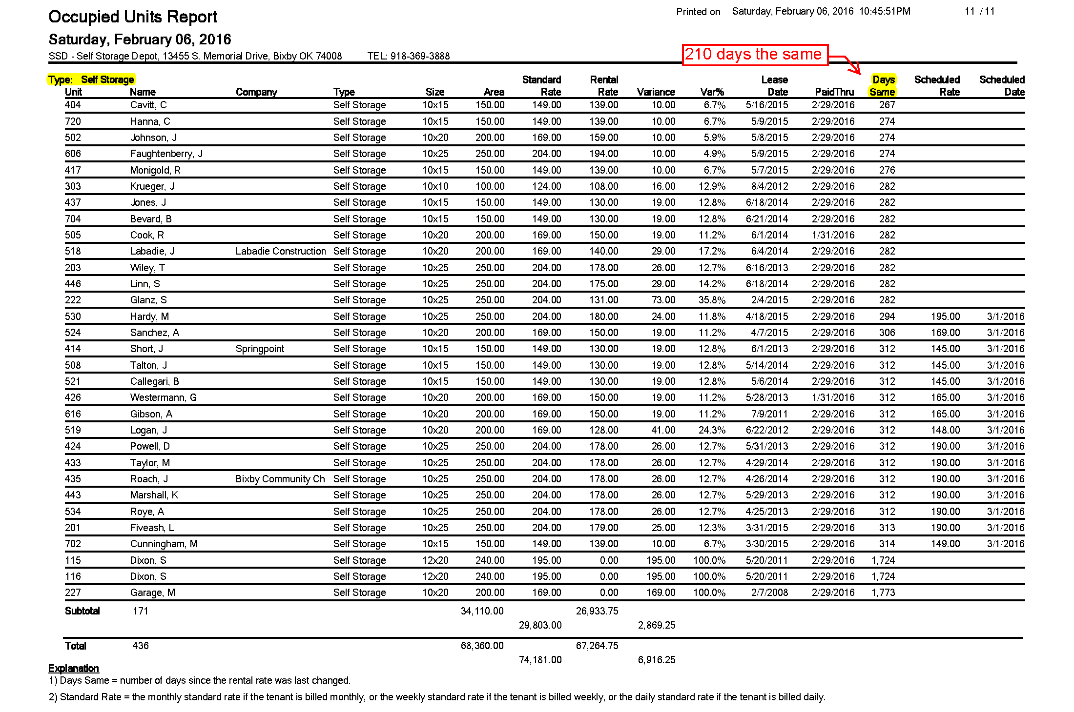
270+ Days the Same
These were increased last month
Pearls of Wisdom Tout Universal Storage Group 770-801-1888
44

Slide 45
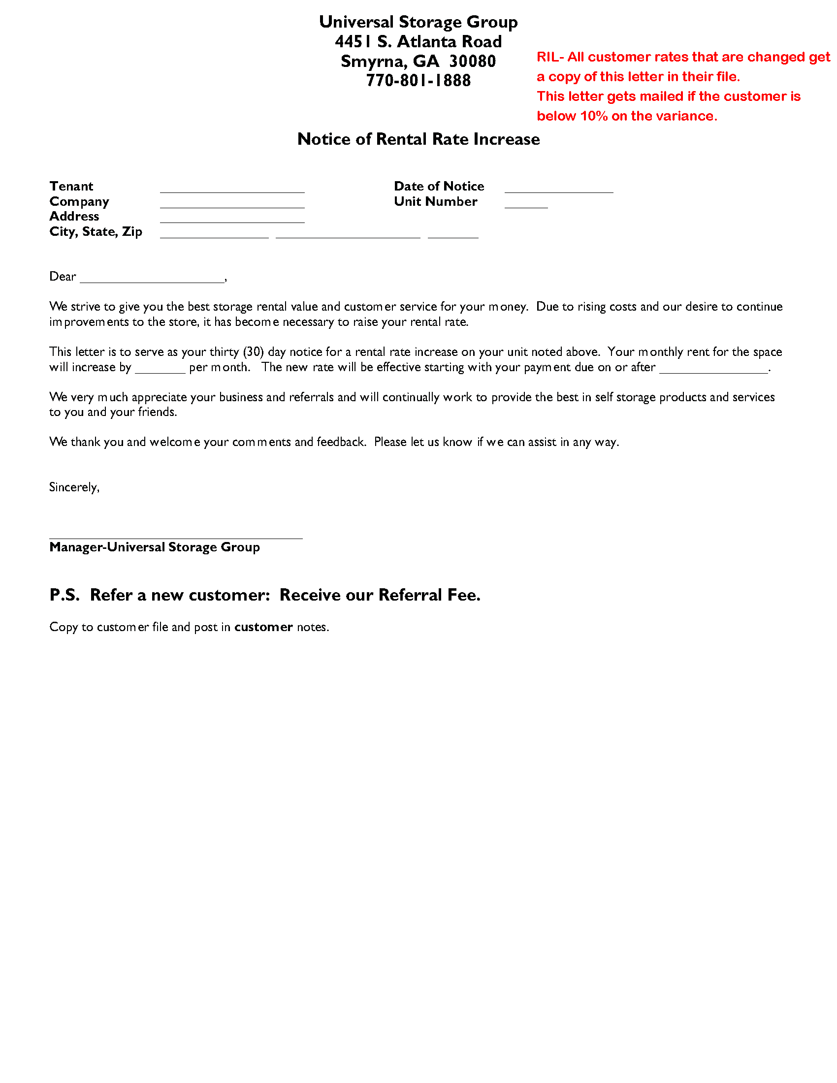
Which Letter Do You Use?
If the Rent Variance for a particular customer is 10-15% or less, use a Rent Increase Letter (RIL)
  Some States Require
  Verified or Certified Mail
  Some States Allow
  Email Notifications
  Either Way, Place
  a Copy in Their File!
Pearls of Wisdom Tout Universal Storage Group 770-801-1888
45

Slide 46
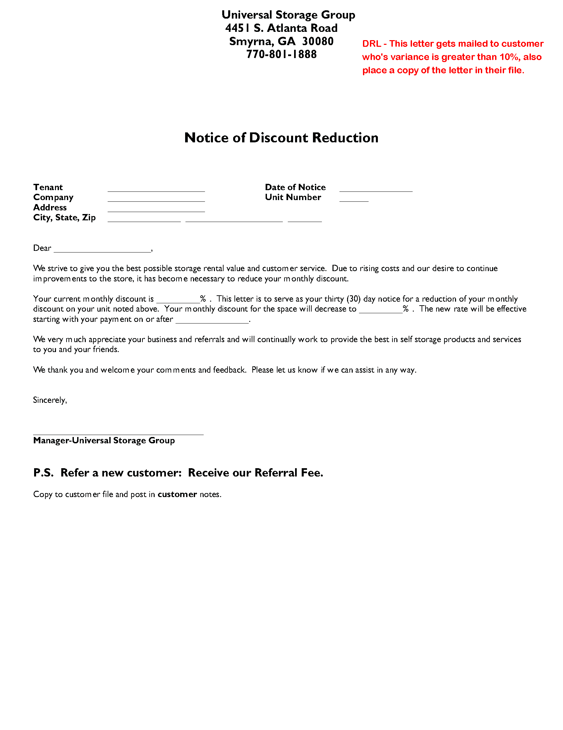
Which Letter Do You Use?
If the Rent Variance for a particular customer is 20% or more, use a Discount Reduction Letter (DRL)
  Create and Place
  a Copy of Both the
  DRL and the RIL in
  Their File.
  Only the DRL is
  Mailed, But There
  Will Be Two Letters
  in their File.
Pearls of Wisdom Tout Universal Storage Group 770-801-1888
46

Slide 47
Once the Letters Go Out…
Put On A Smile And Be Ready To Answer The Phone!
It’s Your Chance To Work With The Customer, Should He Or She Reach Out Or Be Upset.
Discuss The Situation In Order To Find A Middle Ground. Always Check Their File First.
Ask Them What They Think Is Fair.
“If I Could ______, Would You Be Happy?”
Remember That You Are Trying To Reach Your Budget And Income Goals To Improve Property Value.
Pearls of Wisdom Tout Universal Storage Group 770-801-1888
47

Slide 48
Miscellaneous Unit Types
Complimentary Units- Need Rate Management Too
Ex: Charity Unit Might be Free the First Year or Two, Then 25% Increase, Then 50% Increase. Always Make Sure You Are Getting Something in Return.
Ask Owners at Move In How Long They Want to Give Complimentary Units. Use Reminders and Notes.
Owner, Company Units, Manager Units, and Complimentary Units- All Units Must Have a Lease
Company Units: These Units Will Show Up At The End Of The Occupied Units Report Because They Are Not Subject To The DRL/RIL Process. You Will See Very High “Days The Same” With These Units….Don’t Change Their Rent.

Slide 49
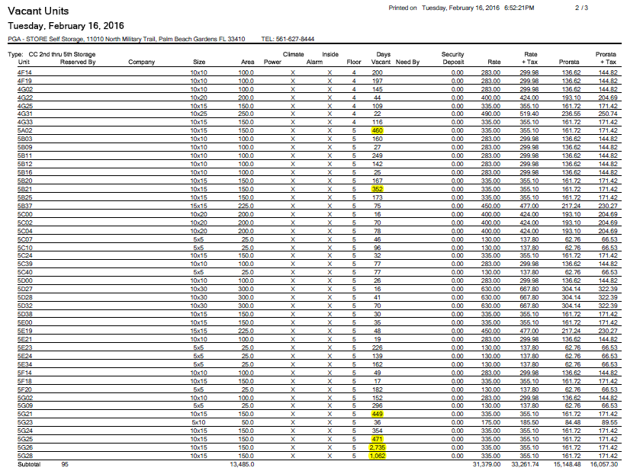
Vacant Unit Types
Find Out How Long the Unit Has Been Vacant
Print the Vacant Units List Sorted by Individual Units and Find the Ones That Have Long Vacancy Days
Put Notes on These Units. Don’t Change Standard Rates on Single Units Ever. People who get discounts should be assigned these units.

Slide 50
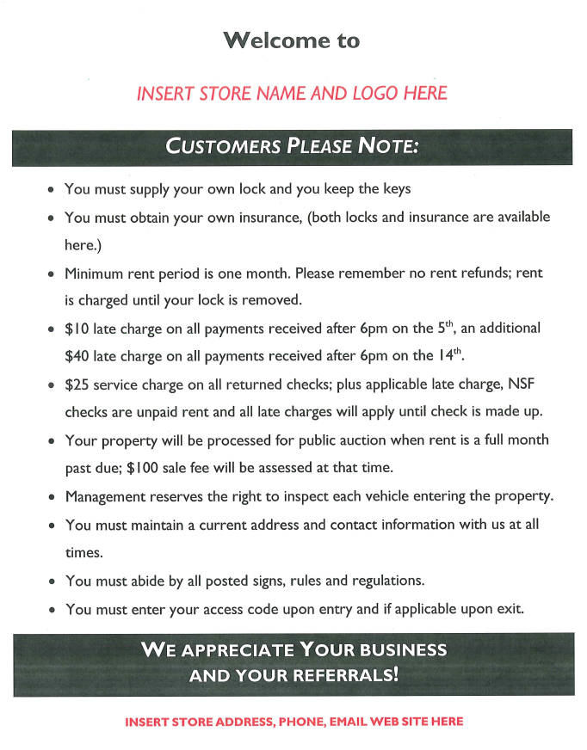
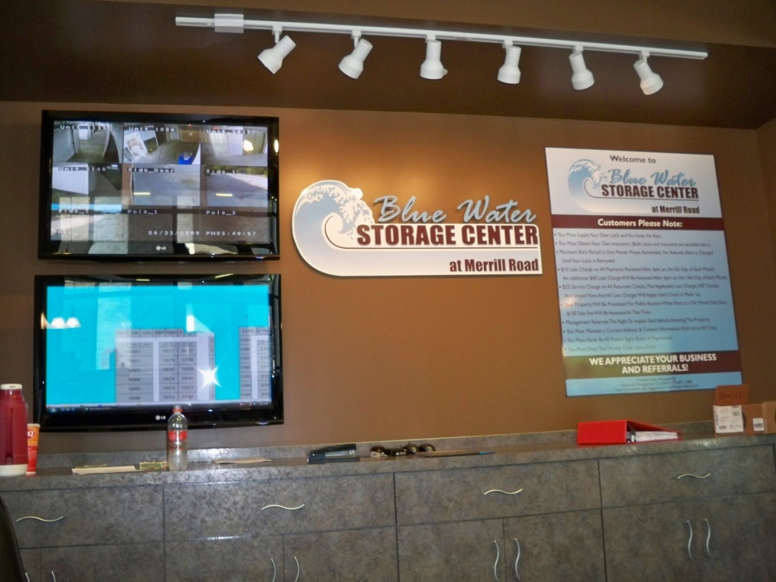
One Set Of Rules
One Set of Rules for everyone.
Why Is It Important To Vanna White Each Move In?
Make A Large Sign and Post For All To See, Give Them A Demo of It, or go Electronic
Pearls of Wisdom Tout Universal Storage Group 770-801-1888
50

Slide 51
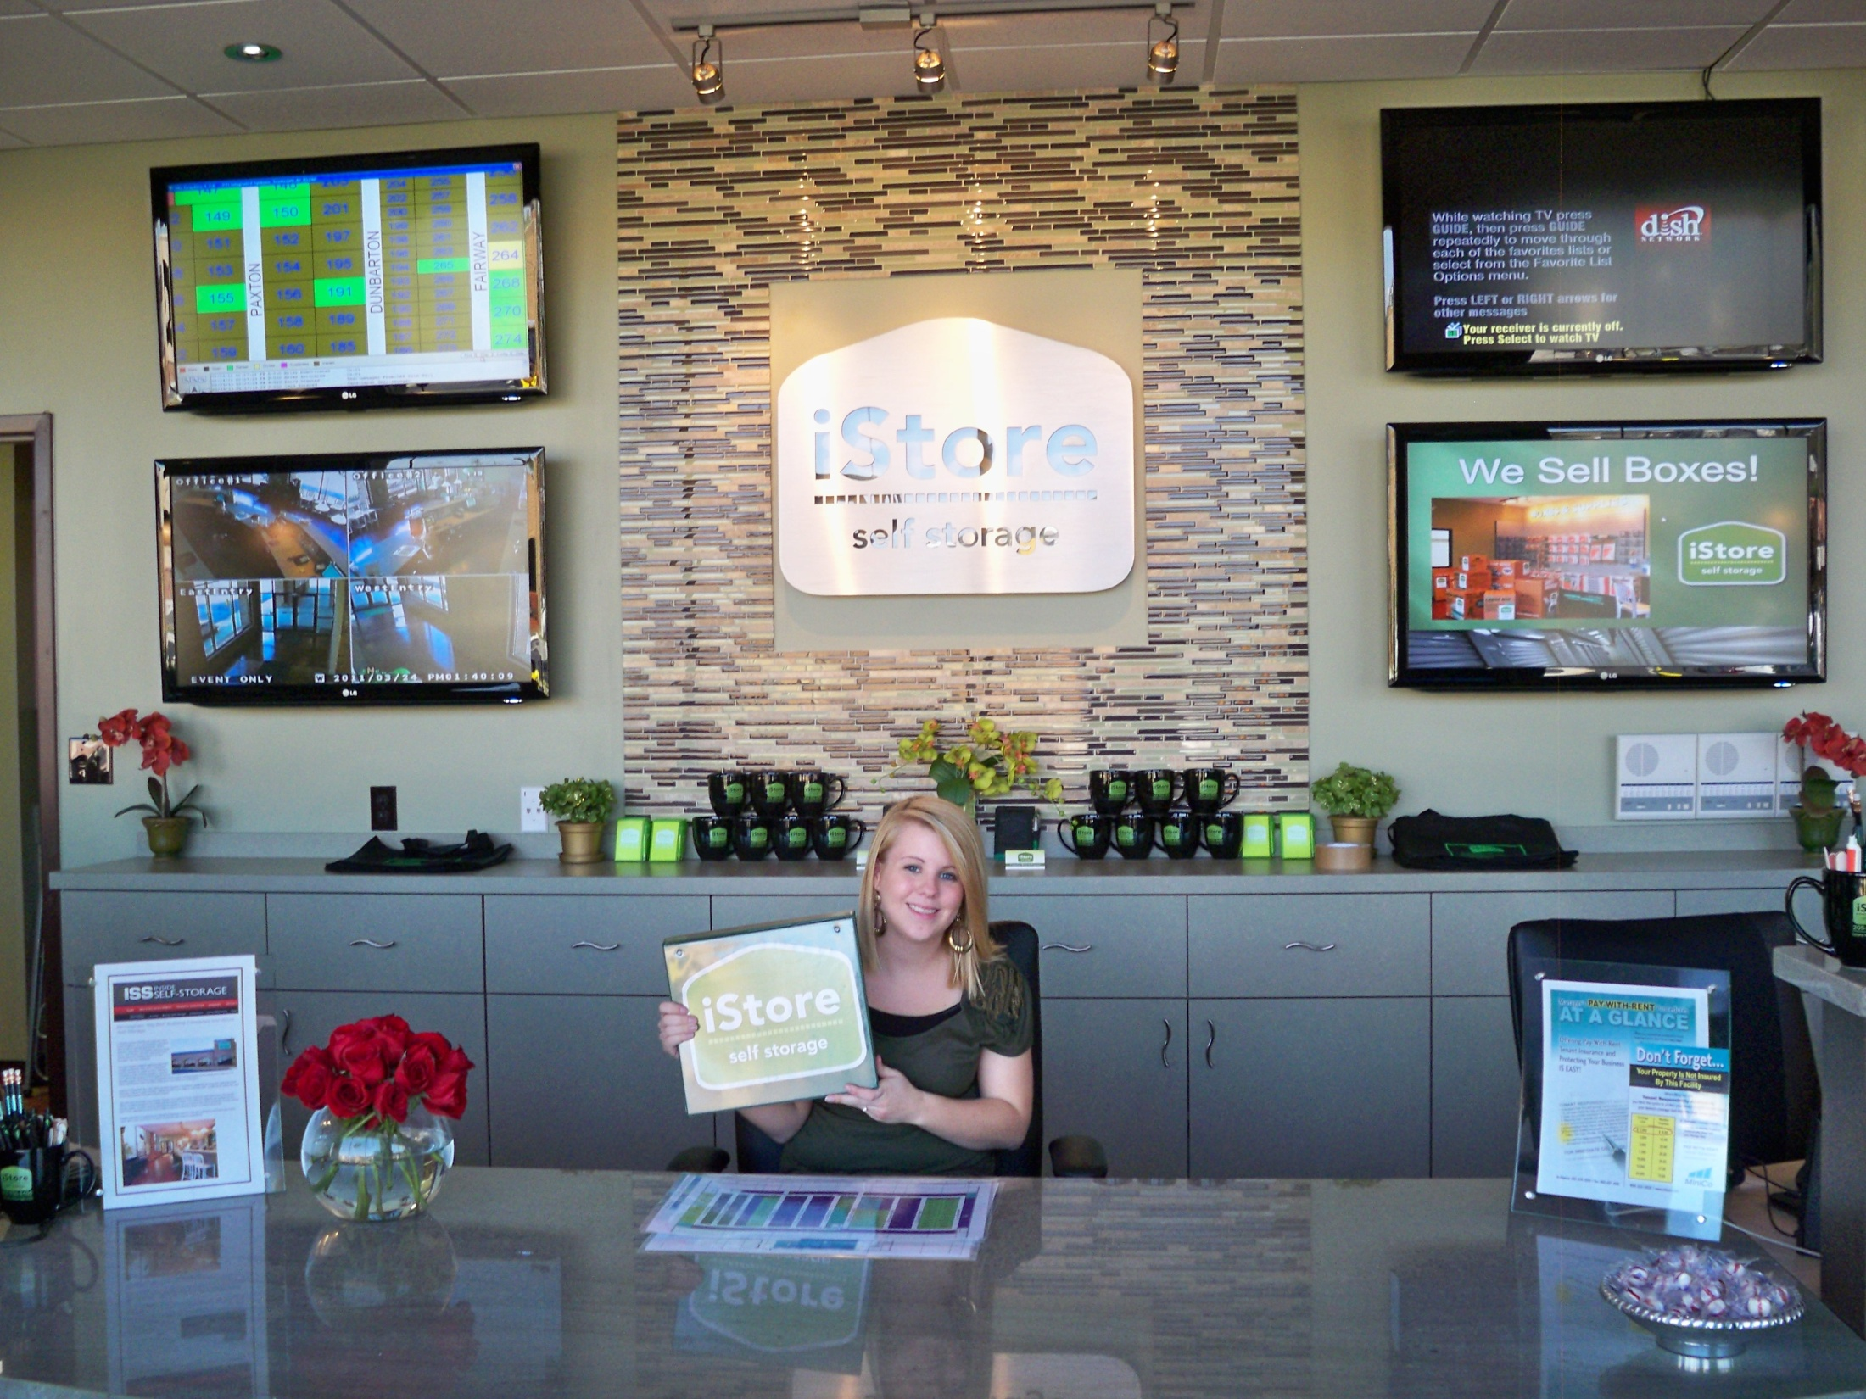
This is the Vanna White Electronic Version
51
Pearls of Wisdom Tout Universal Storage Group 770-801-1888
51

Slide 52
Management Expectations
Expect A Daily Close And Balance, Bank Deposit
Expect Cleanliness Everywhere, No Matter How Old
Expect Concise Written or Digital Instructions For All Processes; Otherwise, Everyone Is Guessing “How To”
Expect Standards and Goals To Be Provided For All Areas, Not Just “Do Good” As Instruction!
Expect To Measure Performance, Daily, Weekly, Monthly annually and & Provide At Least Annual Performance Evaluations
Expect To Succeed With Consistent Inspections Of All Areas You Deem Important; Monthly Supervisor & Auction Coordinator
Expect Marketing And Rate Management Every Week Or Month
Expect To See At Least A 10% Improvement !

Slide 53

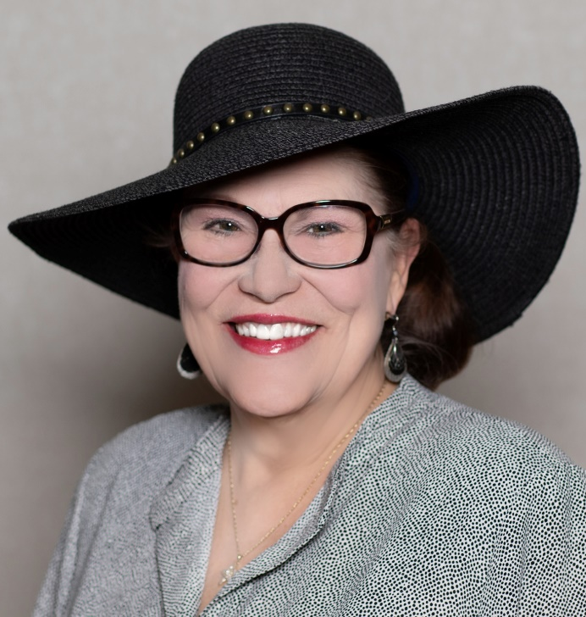
Thank You Arkansas Members & Guests
M. Anne Ballard
Universal Storage Group
2700 Cumberland Parkway
Suite 530
Atlanta, GA 30339
www.universalstoragegroup.com
Pearls of Wisdom Tout Universal Storage Group 770-801-1888
53

Slide 54
10+10=100
Managers Workshop
Arkansas
M. Anne Ballard
President of Marketing, Training, and Developmental Services

Slide 55

Marketing Metrics

Slide 56
10 Marketing Metrics
Conversion
Calls-Walk Ins- Leases
Phone Shop Scores
Cost Per Lease
Source % DB, INT,
RREM, ADS, and Other
Marketing Visits #
Email # Sent & Open Rate
Web / Smartphone %
Referrals #
Online Visitor & Reservations #
Net Gain Rentals

Slide 57
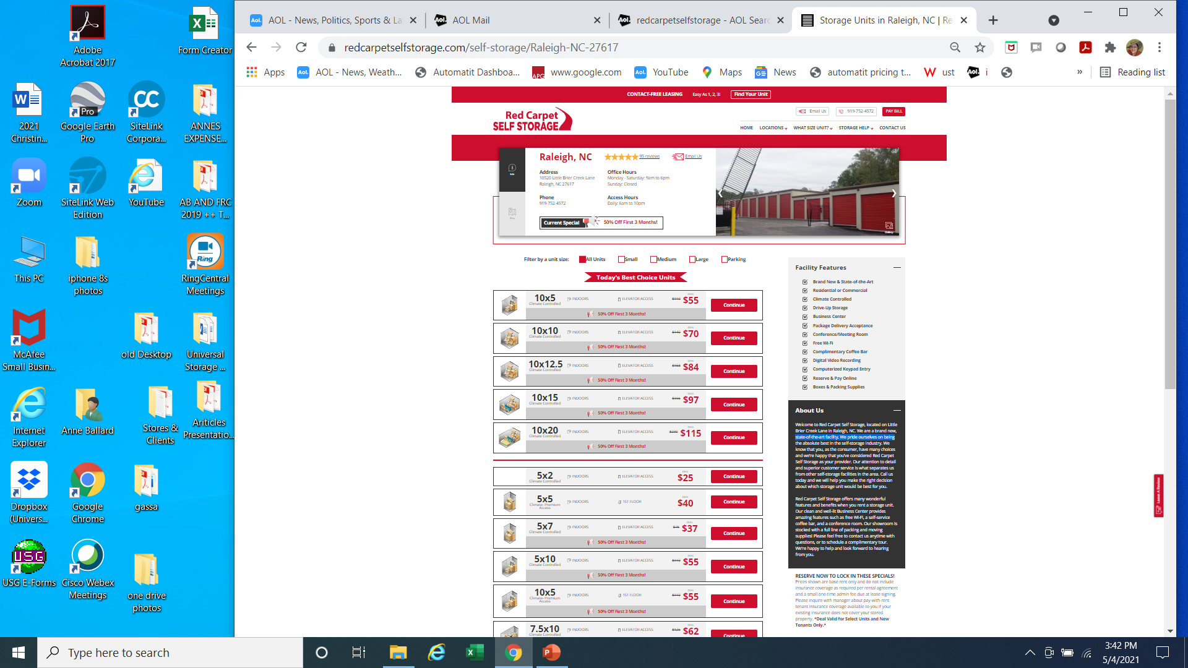
Win On The Web, Your Website Must:
Take Payments
Rent and Reserve Units
Show Pricing
Manage Promotions
Effective PPC Campaign
Works on Phones/Tablets
Show Photos
Google Reviews

Slide 58

Self-Storage Marketing
Set Goals to Fit Your Store
  How many physical marketing visits?
  Consider staffing, days available, budget for promos/giveaways
  Start with 40 visits a month –
  that’s only 10 a week!
  40 a month for a year is 480 Visits!
  Track the number of visits made –
  set a Goal!
  What gets measured gets done!
Pearls of Wisdom Tout Universal Storage Group 770-801-1888
58

Slide 59

Self-Storage Marketing Visits
Take Something, Leave Something
Always Take Away A Business Card, Brochure, Flyer From The Business You Are Visiting.
Always Leave Something 3-dimensional With Each Contact You Make:
  Not Just Your Business Card Or Brochure!
  Paper Gets Thrown Away
  Pens, Cups, Goody Bags, Promo Items, Etc.
  Preferably Something They Will Use
  Don’t Forget The Power Of Treats!
Pearls of Wisdom Tout Universal Storage Group 770-801-1888
59

Slide 60
Marketing
Its About Building Your Brand
Back Out On The Streets Now
Making It Easy To Market Outside The Office
Set Some Simple Goals
A Little Each Day Is The Way
4 Areas Of Involvement
Everyone Can Do This
Measure Results Monthly For A Great Year
Pearls of Wisdom Tout Universal Storage Group 770-801-1888
60

Slide 61
Generating Our Own Traffic
Now Up To Each Of Us To Generate Our Own Onsite Traffic In The Community
Tools We Use Are:
  Community Involvement
  Visits To All Local Retail & Other Organizations
  Follow Up & Market Electronically
  Host Events Community Is Interested In Attending
NOTE: We Will Not Be Able To Out Bid REIT’S For PPC So We Have To Come Up With A Different Plan To Rank Higher In The Organic Results & Local Mindset
61
Pearls of Wisdom Tout Universal Storage Group 770-801-1888
61

Slide 62
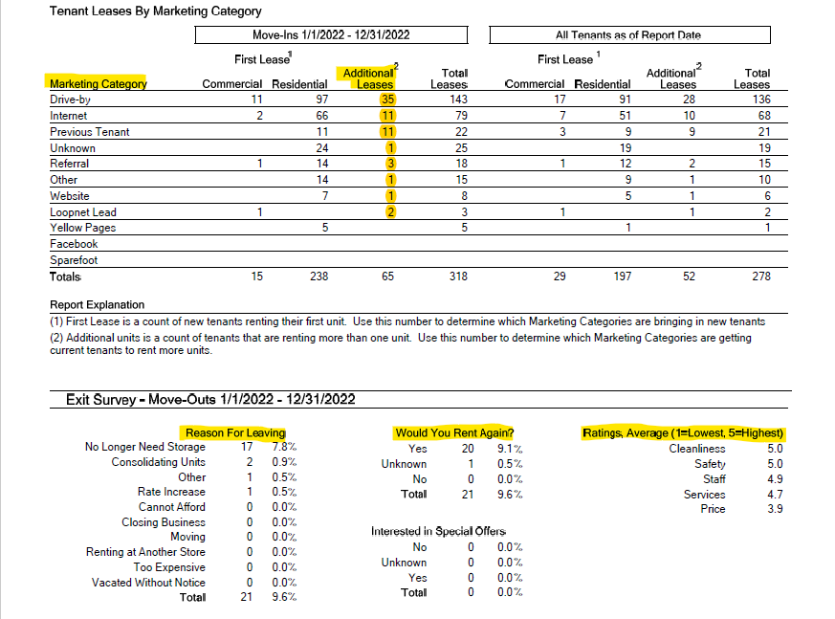
What Are Your Marketing Numbers

Slide 63
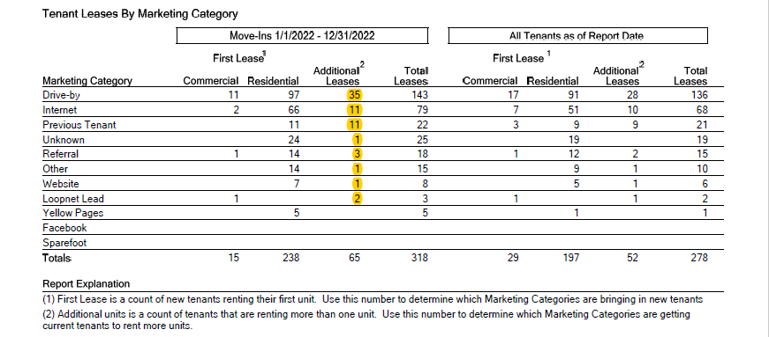
What Are Your Marketing Source Numbers
What Is Your % From Drive By, Internet, Marketing, Event, Repeats, Referrals, and Ads/Other
Additional Leases are Considered Repeats and are Subtracted From That Source Added To RREM
This Example: Drive By- 33.96% Internet- 23.58% Other- 13.85% RREM- 28.61%
Must Know The Percentage Of Your Traffic From:
1- Drive By
2- Internet
3- RREM (Repeat, Referral, Events, Marketing
4- Ads/Other
NEVER USE UNKNOWN OR OTHER, LIST EACH ACTIVITY YOU PAY FOR, CHAMBER, PPC, REFERRALS, FACEBOOK ADS, SPAREFOOT, ETC.

Slide 64
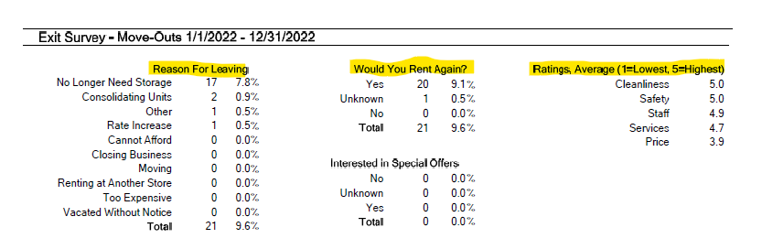
Why Did They Move Out / What Is Your Rating
Send Move Out Surveys From SiteLink and Track The Responses

Slide 66
manneballard@aol.com Universal Storage Group 770-801-1888
66

Slide 71
manneballard@aol.com Universal Storage Group 770-801-1888
71

Slide 76
USG Managers Personal Marketing Goals Achieved 2022
Cost per Lease $81.45
CPL = ALL MARKETING AND ADVERTISING COSTS ÷ ALL LEASES
Pearls of Wisdom Tout Universal Storage Group 770-801-1888
76

Slide 77
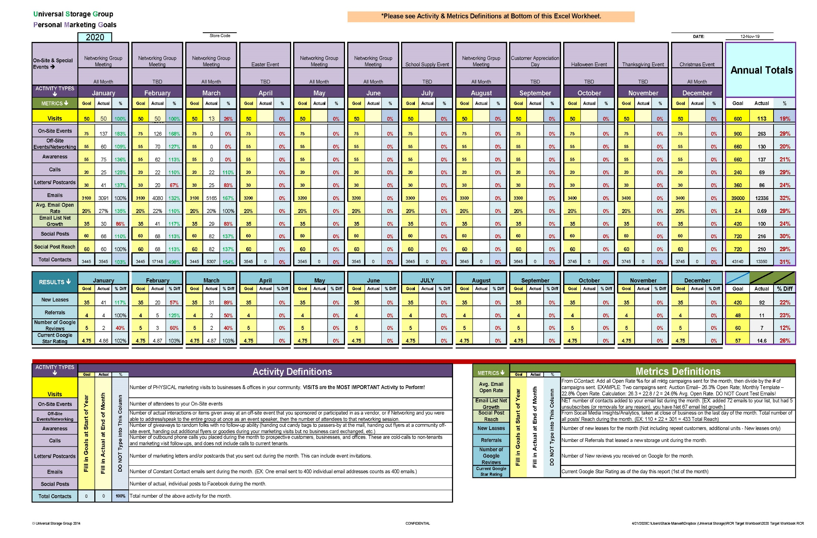
PMG- Personal Marketing Goals
A One Page Per Store Annual Plan & Measurement Tool
Easy To Use And Easy To Understand
Sent Via Email On The First Of Each Month For The Prior Month’s Activity
Stores averaged 66,238 Marketing Messages for 1st half 2011 or 11,040 per month per store

Slide 78
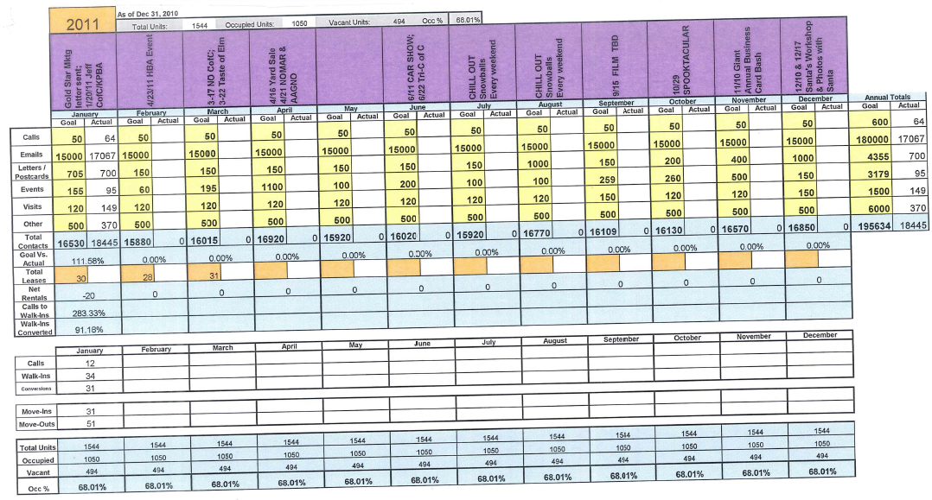
Managers Personal Marketing Goals
BY YEAR’S END YOU WILL HAVE A TOTAL NUMBER OF CONTACTS AND MESSAGES IN THE MARKETPLACE THAT WILL AMAZE YOU AND BRING NEW RENTALS
PRE PLAN YOUR ONSITE ACTIVITIES FOR THE YEAR SO YOU CAN MARKET THEM 90 DAYS IN ADVANCE
SET GOALS FOR EACH MARKETING ACTIVITY AND REPORT ACTUAL NUMBERS ACHIEVED AT MONTH’S END
GET THE WHOLE TEAM INVOLVED IN SENDING OUT LETTERS, CALLING, EMAILING, ATTENDING LOCAL MEETINGS, VISITING LOCAL BUSINESSES.

Slide 79
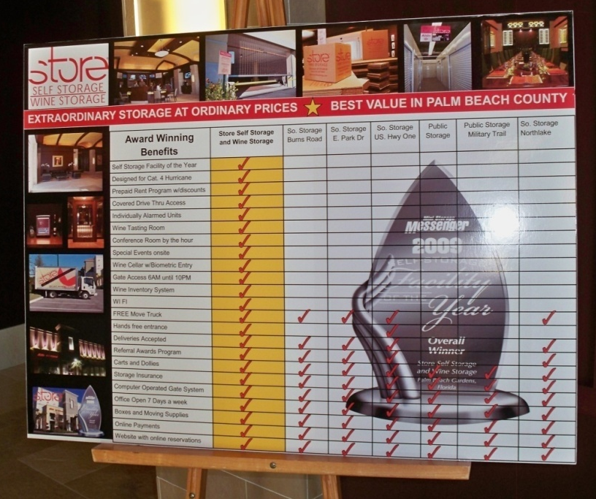
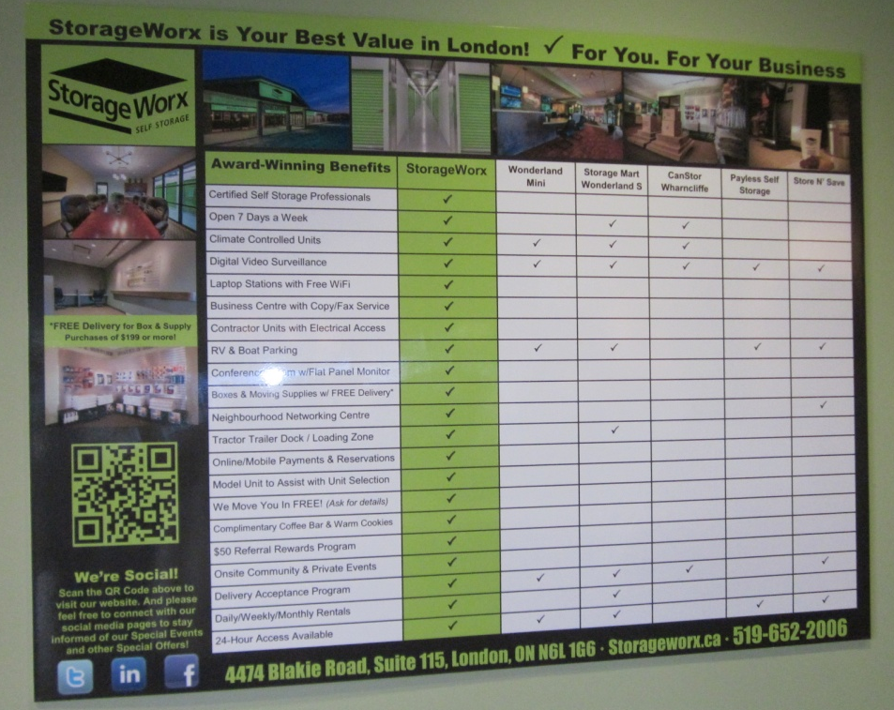
Use Your Competition Survey to Prove You Are the Best Value
(not the cheapest but the best value)
Don’t Get Trapped Into “Price Only” Selling. Customers Need To See For Themselves, Show The World You Know!
Pearls of Wisdom Tout Universal Storage Group 770-801-1888

Slide 80
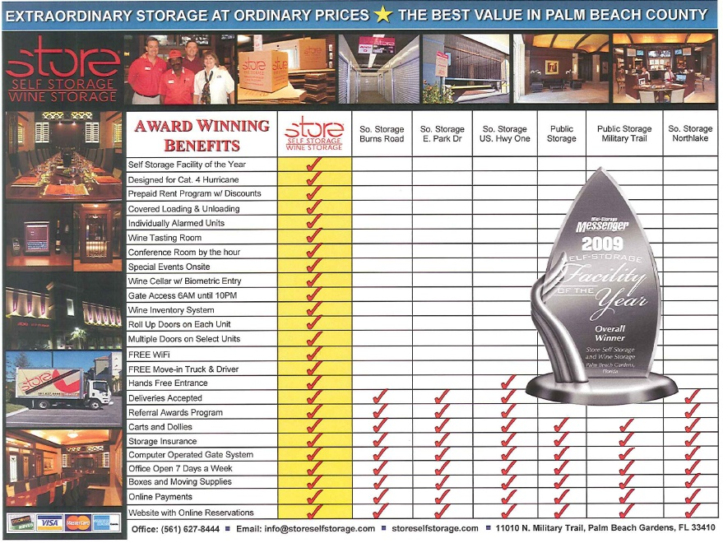
Demonstrate You Are An Expert And You Can Quit Discounting!
manneballard@aol.com Universal Management Company 770-801-1888

Slide 81

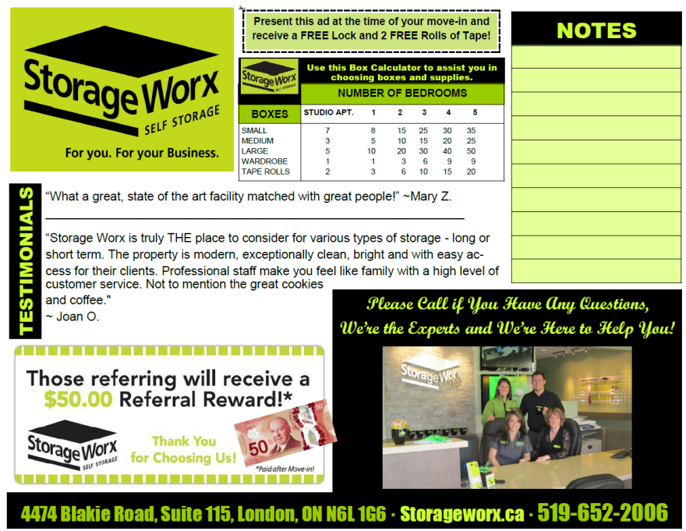
Have You Completed Your
Comparison Handout?
A Powerful Selling Tool!
Pearls of Wisdom Tout Universal Storage Group 770-801-1888
81

Slide 82



Groups To Target For Your Marketing Visits That Need Storage or Can Send You Referrals
#1 - Sell Your Competitors, Share Referrals
Groups To Target
  Apartments, Real Estate Offices, Moving Companies, Building Managers, BOMA, IREM, Apartment Associations
  Doctors, Dentists, Chiropractors, Title Companies, CPA’s,
  Attorneys, Banks, Professional Services
  Service Businesses, Local Retailers, Interior Designers
  Distribution, Manufacturer’s Reps, Truck Based Businesses
  Schools, Universities, Large Employers, Hospitals
  Non Profits, Government
  RV/Boat & Motorcycle Dealers
  Homeowners Associations, Trailer Parks
  Crisis Centers, Insurance Companies, Fire & Disaster Clean Up
  Chamber Members, other Club Members
  Churches and Synagogues
Pearls of Wisdom Tout Universal Storage Group 770-801-1888
82

Slide 83

Website Metrics to Track and Why

Slide 84


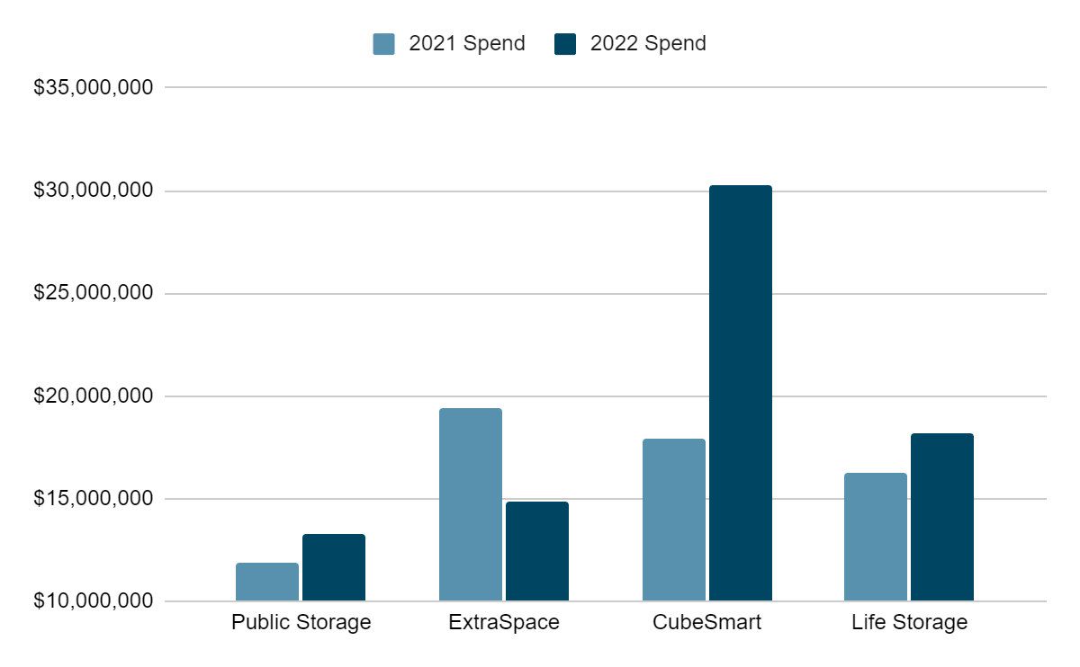
2022 REIT SPEND
In 2022, all REITs increased spend by 117%, averaging Google Paid Media spend between $1 Million to $3 Million Dollars per month.
Pearls of Wisdom Tout Universal Storage Group 770-801-1888
84
Notes:
YoY, we have seen great increases in conversions due to the optimizations we have made over the past year, including prioritizing rentals and adding new facilities.
We have seen our average ranking increase as well, which is getting us seen more on Google.
Google is trying to remain competitive with their chatbot, but during their first showing, it made a technical error. It remains to be seen how AI will be further integrated into search.
Congress is in the process of determining whether Facebook, Google, and others will be responsible for the content published on their site. If this is pushed forward, it will make Google and Facebook have to moderate content a great deal more.

Slide 85
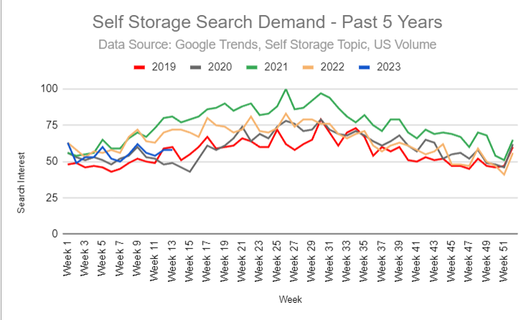
Storage Related Searches
Storage related searches are down compared to 2021 and more in line with 2019 trends.
Pearls of Wisdom Tout Universal Storage Group 770-801-1888
85
Notes:
YoY, we have seen great increases in conversions due to the optimizations we have made over the past year, including prioritizing rentals and adding new facilities.
We have seen our average ranking increase as well, which is getting us seen more on Google.
Google is trying to remain competitive with their chatbot, but during their first showing, it made a technical error. It remains to be seen how AI will be further integrated into search.
Congress is in the process of determining whether Facebook, Google, and others will be responsible for the content published on their site. If this is pushed forward, it will make Google and Facebook have to moderate content a great deal more.

Slide 86
2022 Inquiries
All Stores
 | Reservations | Rentals
Total Inquires | 4,613 | 1,757
Total Phone Calls* | 58,146
Same Store
 | Reservations | Rentals | Calls*
Total Inquires | 2,474 | 2,441 | 2,941
Data is pulled from 1/1/22 - 12/31/22
Rentals & Reservations are website only
*Calls > 60 sec & all GBP Calls
Cost/Lead
$36
Pearls of Wisdom Tout Universal Storage Group 770-801-1888
86
Notes:
YoY, we have seen great increases in conversions due to the optimizations we have made over the past year, including prioritizing rentals and adding new facilities.
We have seen our average ranking increase as well, which is getting us seen more on Google.
Google is trying to remain competitive with their chatbot, but during their first showing, it made a technical error. It remains to be seen how AI will be further integrated into search.
Congress is in the process of determining whether Facebook, Google, and others will be responsible for the content published on their site. If this is pushed forward, it will make Google and Facebook have to moderate content a great deal more.

Slide 87
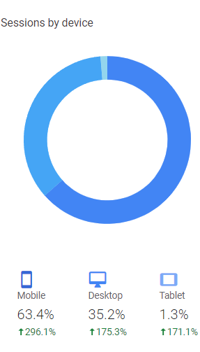
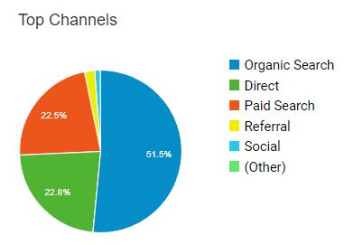
Website Results
Pearls of Wisdom Tout Universal Storage Group 770-801-1888
87
Notes:
YoY, we have seen great increases in conversions due to the optimizations we have made over the past year, including prioritizing rentals and adding new facilities.
We have seen our average ranking increase as well, which is getting us seen more on Google.
Google is trying to remain competitive with their chatbot, but during their first showing, it made a technical error. It remains to be seen how AI will be further integrated into search.
Congress is in the process of determining whether Facebook, Google, and others will be responsible for the content published on their site. If this is pushed forward, it will make Google and Facebook have to moderate content a great deal more.

Slide 88
2022 Year End Review
Paid Media
Overall spend - $381,434**
Clicks - 67,748
Impressions - 1,037,068
Click Through Rate - 6.64%
Conversions* - 8,267
Cost/Conversion - $46.14
Conversion Rate - 12.16%
Organic
Users - 183,442
Sessions - 276,492
Bounce Rate - 41.65%
Calls (over 60 seconds) - 11,198
Reservations - 4,613
Rentals - 1,757
Conversion Rate - 29.02%
Go Local Website Launch - Nov. 1, 2021
*Conversions are calls over 60 sec., SE reservations, SE rentals
**Includes only Paid Media Spend
Pearls of Wisdom Tout Universal Storage Group 770-801-1888
88
Notes:
YoY, we have seen great increases in conversions due to the optimizations we have made over the past year, including prioritizing rentals and adding new facilities.
We have seen our average ranking increase as well, which is getting us seen more on Google.
Google is trying to remain competitive with their chatbot, but during their first showing, it made a technical error. It remains to be seen how AI will be further integrated into search.
Congress is in the process of determining whether Facebook, Google, and others will be responsible for the content published on their site. If this is pushed forward, it will make Google and Facebook have to moderate content a great deal more.

Slide 89

Self-Storage Marketing
Hosting On-site Events
    For A Successful Onsite Event You Need To Be Marketing The Event At Least 90-120 Days Prior
    Begin Marketing With A Save The Date Email
    Approximately 10% Of Those Invited
    Will Attend If They Receive Multiple Invites – Delivered In Person, By Mail, And Via Email.
    Get Local Businesses &Chamber Involved
    Invite Everyone, Chamber Usually Sends 2 Email Invites For You, Businesses Do Social Posts/Email To Help Spread The Word!
Pearls of Wisdom Tout Universal Storage Group 770-801-1888
89

Slide 90
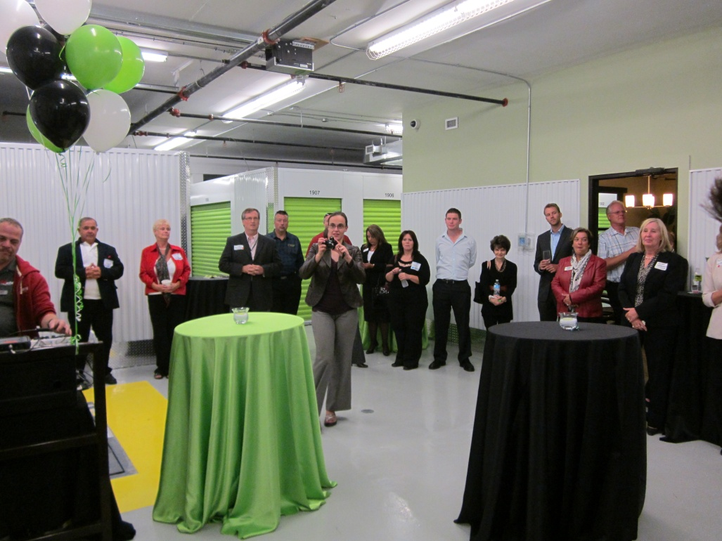
Self-Storage Marketing
Hosting On-site Events
Event Planning Considerations
    Traffic Flow – Parking And Foot Traffic Through Site
    Staffing – Make Sure You Have Enough People- Get Local Businesses To Partner With You For Extra Hands!
    Catering – Drinks, Food, Tableware, Tables, Chairs
    Door Prizes – Storage Unit For 6 Months, Local Businesses Donations, Wine/Movie Night Basket, Etc.
    Goodie Bags To Everyone –
    Include Special Double Referral
    Cards From Event
    Don’t Forget The TRASH CANS!
    (Small Box, Top Flaps Up
    With 50gal Liner!)
Pearls of Wisdom Tout Universal Storage Group 770-801-1888
90

Slide 91

Self-Storage Marketing
Create & Host a Networking Group
It’s Easier Than You Think!
    Open To All – Free to Join
    Use Facebook Events to Organize & Collect RSVPs
    Small Fee ($2-3)at Door For Refreshments, Snacks
    Have A 50/50 Raffle (sell tickets at door),
    Half To Winner, Half To Charity
    Introduce Yourself and Greet Attendees
    Then Introduce 1 or 2 Speakers Each Month – Pick From Members, Give 5 Minutes Each to Speak About their Business
    Then Let Everyone Mix & Mingle
    for 30-45 Mins.
    Conclude Event By Drawing Raffle & Announce Next Month’s Speakers.
Building Alliances = Mutually Beneficial Connections:
They Refer Customers to You, and You Refer to Them
Pearls of Wisdom Tout Universal Storage Group 770-801-1888
91

Slide 92


Referrals & Reviews
Often the Lowest Cost Per Lease and Already Sold; Easy to Close and Get More Referrals From.
What Do They Respond To?
    Money
    Gift Cards, American Express or Visa Cash Cards
    Gas Cards or other Local Business Gift Cards/Gift Certificates
Not Rent Credits
No Need to Give Anything to New Customer
Must Be Enough To Grab Their Attention!
Pearls of Wisdom Tout Universal Storage Group 770-801-1888
92

Slide 93
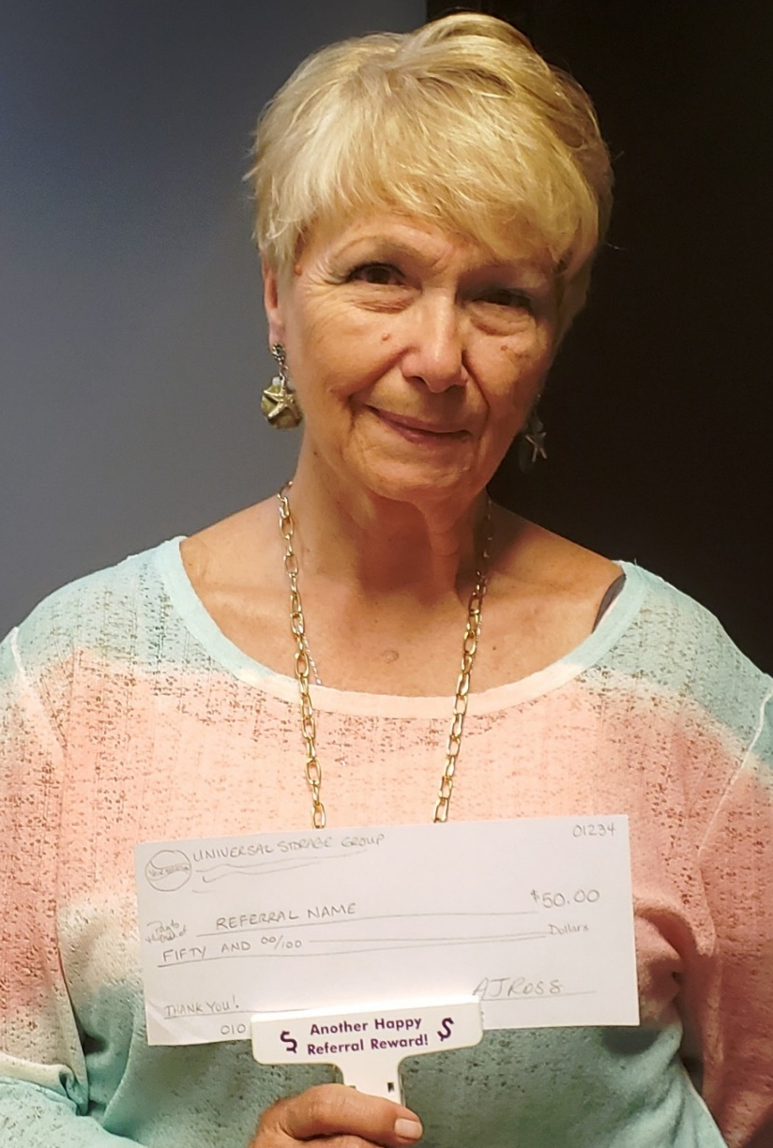
Self-Storage Marketing
Referrals
Take Photos Of Referral Reward Recipients For Your Social Media And Email Blasts.
Pearls of Wisdom Tout Universal Storage Group 770-801-1888
93

Slide 94

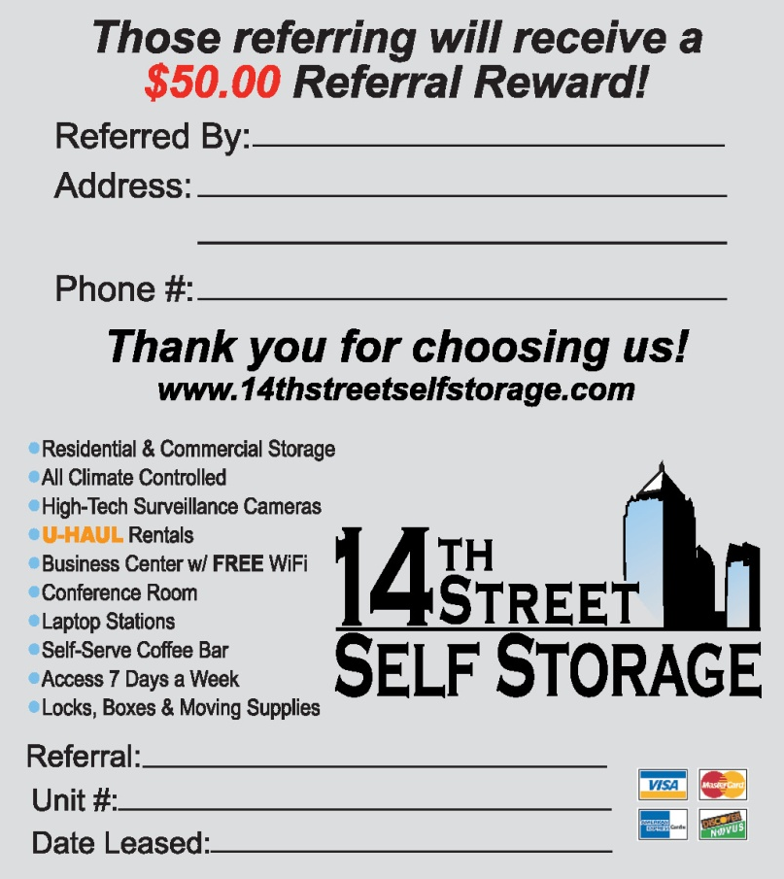
Getting More Referrals & Tons Of Testimonials
Front Of Foldover Card
Have Your Referrals Increased This Year?
Keep Your Phone Ready To Grab That Photo, Video & Testimonial Or Referral Check Recipient
Post These Photos & Statements/Captions To Your Facebook Page & Website
Get Passionate About Referrals With Every Interaction Put Them In Their Hands
Pay Referral Fee To Anyone, Not Just Customers
Send Out Referral Cards In All Snail Mail
Post Referral Program To All Online Sources
Inside Of Foldover Card
Pearls of Wisdom Tout Universal Storage Group 770-801-1888
94

Slide 95


Self-Storage Marketing
The Proof Of The Pudding
  Online Reviews Work To Your Advantage
  Having Lots Of Reviews Online Helps Your Image
    Even The Bad Ones!
    Use Your Responses To Showcase Your Superb Customer Service
    It Takes 20 5-star Reviews To Offset One 1-star Review!
Pearls of Wisdom Tout Universal Storage Group 770-801-1888
95

Slide 96

Marketing: Phone
Call Your Comps And Inquire About Their Activity
  Are They Busier Or Slower?
  Can You Trade Leads For Unit Types
  That You Each Have/Don’t Have?
Call Local Businesses And Inquire How They Are Doing Or If You Can Help.
  Don't Try To Turn It Into A Sales Call. They All Know What You Do And It Will Seem Disingenuous.
  Share Advice/Empathize With Those That Need It, Even If You Don't Know Them Well.
Call Or Email Your Customers To Simply Let Them Know You're Thinking About Them.
Pearls of Wisdom Tout Universal Storage Group 770-801-1888
96

Slide 97

Marketing: Email
Email Ideas!
Google Reviews have hit a Standstill!
  Why not create an email to send to
  your customers with the Google Review
  Link in it? (Copy the Link from your Google Cards)
Advertise Easy Code Access
Advertise Box & Supply Curbside Pickup
Advertise Business of the Month
Advertise No-Contact Leasing
Include Videos (More on that in a minute…)
Pearls of Wisdom Tout Universal Storage Group 770-801-1888
97

Slide 98





Email Marketing
Sign up for Constant Contact accounts
Very easy to create, send & track email marketing messages
Managers need to attend the FREE Constant Contact workshops in your areas www.constantcontact.com – “In Your Area” tab Or Use Their Online Learning Center for training, immediate help & resources
Constant Contact is CHEAP ($65/mo. up to 2500 Contacts) & it Works!
Build database with “Sign Up” forms on Facebook, Website, Email Signatures & More!
Pearls of Wisdom Tout Universal Storage Group 770-801-1888
98

Slide 99

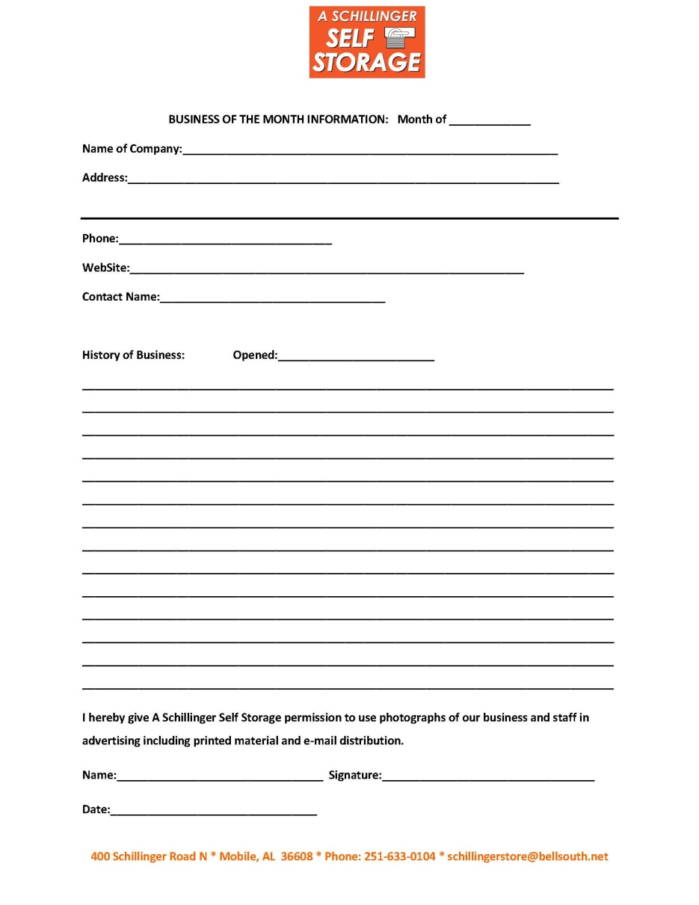
Pearls of Wisdom Tout Universal Storage Group 770-801-1888
99

Slide 100

Marketing: Videos
Create Some Videos To Post To Facebook.
Shoot A Series Of Less Than 1 Minute Long Videos Giving A Tour Of Your Property And Showing Off The Unique Features That Make You The
Best Choice In Self Storage In Your Market!
  Talk About Our No-contact Leasing And Payment Options
  Boxes And Packing Supplies That Can Be Ordered And Paid For Over The Phone, And Set On The Curb For Easy Pick-up!
  Easy Code No-contact Access, And More!
Anything Can Be Made Into An Adventure, And Right Now The Time Is So Ripe For People To Pay Attention – People Are Literally Starved For Anything To Do…!
You Can Post The Videos In
A Series… Spread It Out And Provide
A Series Of Entertainment.
One Video Per Week Is Good!
It Could Be A Wonderful
“Store-it Saturday” Series!
Pearls of Wisdom Tout Universal Storage Group 770-801-1888
100

Slide 101

Marketing: Testimonials
Video Testimonials From Your Tenants Are Very Powerful Tools!
These Can Be 15-20-second Spots Just Featuring The Tenant Saying Something Nice About The Facility – No Script Needed, Just Wing It!
People Can Sniff Out Ingenuine Scripted Ads From A Mile Away, But If You Let Your Tenants Speak For Themselves, It Will Work Wonders!
These Videos Can Be Shot
While Still Maintaining Safe
Social Distancing At 6ft.
Or Have The Customer
Shoot The Video Themselves
And Send It To You.
Pearls of Wisdom Tout Universal Storage Group 770-801-1888
101

Slide 102
Marketing Expectations
Must Take Some Marketing Actions Each Day
Must Measure Each Rental Source
Must Ask Marketing Questions At Move In
Learn to Meet & Greet
Visits Are Key To Success
Promote A Referral Program Everywhere
Get Your Callers To The Site
Close 90% of Your Onsite Traffic
Improve Online Conversions
Expect To See At Least A 10% Improvement !

Slide 103
Thank You Arkansas Members & Guests
M. Anne Ballard
Universal Storage Group
2700 Cumberland Parkway
Suite 530
Atlanta, GA 30339
www.universalstoragegroup.com
Pearls of Wisdom Tout Universal Storage Group 770-801-1888
103

