Slide 1
Change is in the Air!
Market Update
Cole Carosella
Argus Self Storage Advisors
August 23, 2023

Slide 2
Change is Here!
Market Update
Cole Carosella
Argus Self Storage Advisors
August 23, 2023

Slide 3

It’s Been a Long Run

Slide 4
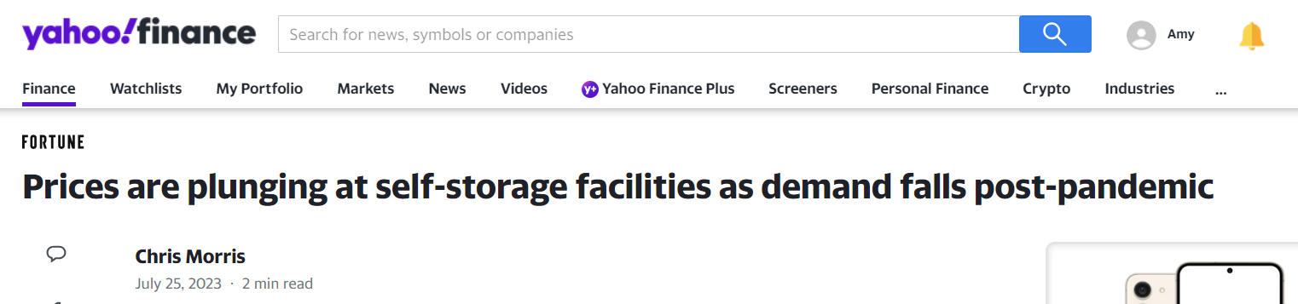
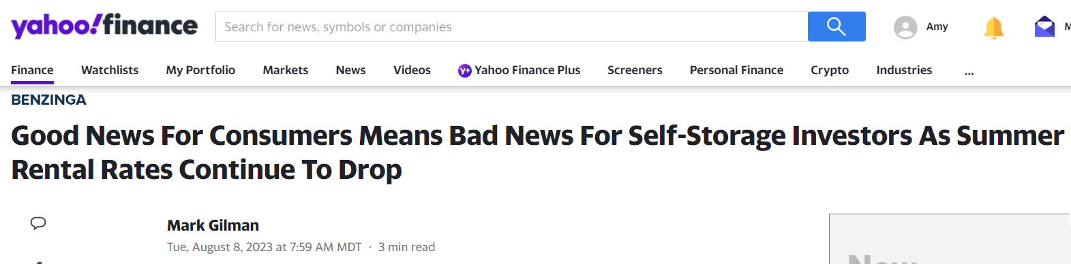
Bad Press
“Rent prices for new customers fell 10% from the first quarter of 2022, the Journal says, quoting data from real estate analytics firm Green Street. That’s the biggest decline on record since 2013 and follows a reduction nearly as large in the fourth quarter of 2022.”
  "We maintained strong occupancy of 94.5%, driving same-store revenue growth of 2.7% in the quarter, despite exceptionally difficult year-over-year comparables from pandemic highs," he said. "We have revised our outlook for the back half of the year due to lower-than-expected new customer rates in June and July.“ – Joe Margolis

Slide 5
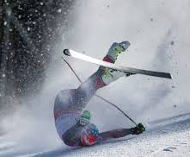
It’s Been a Long Run

Slide 6
Mid-Year Market Update
1
Market Fundamentals
2
Capital Markets
3
Performance and Valuation
4
The Development Wave
5
Understanding the Real Estate Cycle

Slide 7
Mid-Year Market Update
1
Market Fundamentals are Strong, but Softening

Slide 8
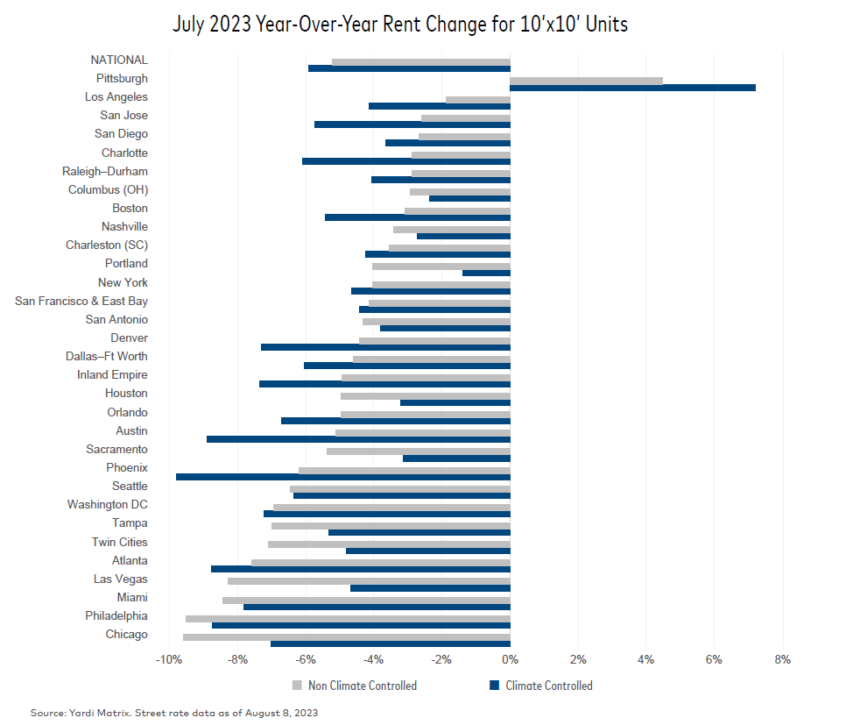
1. Market Fundamentals are Strong, but Softening

Slide 9
1. Market Fundamentals are Strong, but Softening
Source: Yardi Matrix

Slide 10



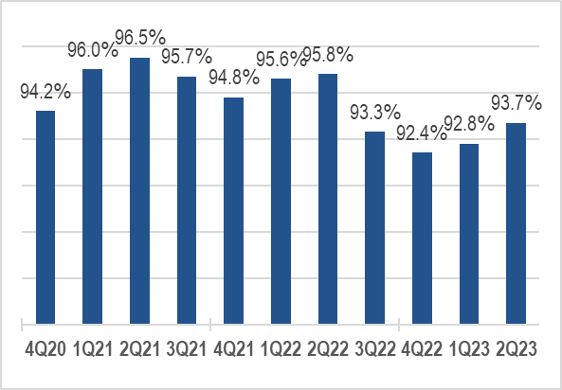
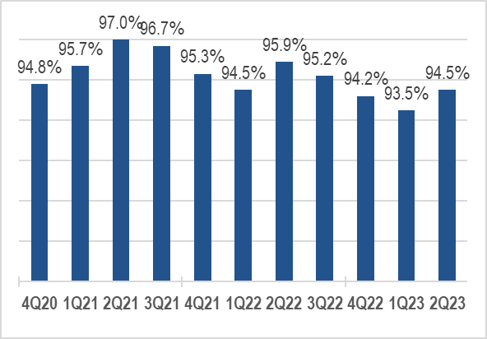
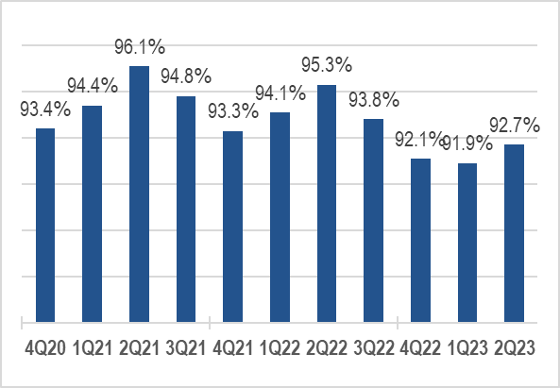



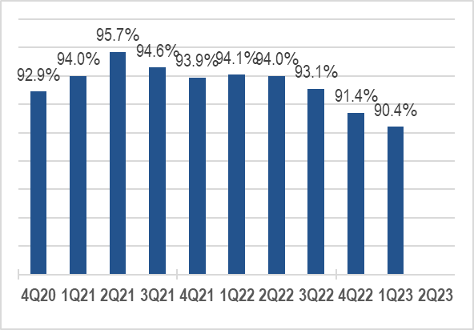
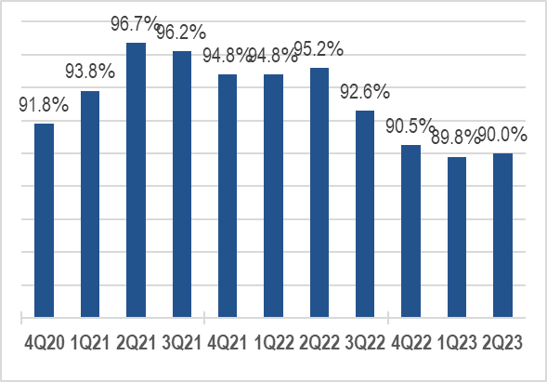
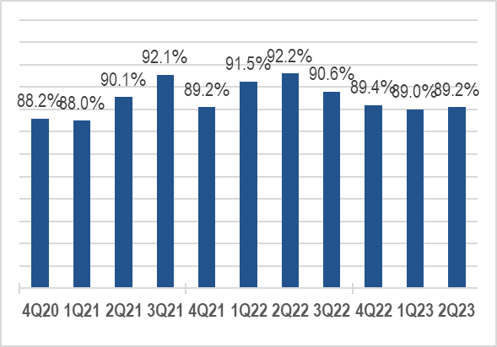
1. Market Fundamentals are Strong, but Softening
Portfolio Occupancy: Same Store
N/A
Source: MJ Partners

Slide 11
1. Market Fundamentals are Strong, but Softening
Source: Extra Space Storage

Slide 12
Mid-Year Market Update
1
Market Fundamentals are Strong, but Softening
2
Capital Markets are Moving

Slide 13
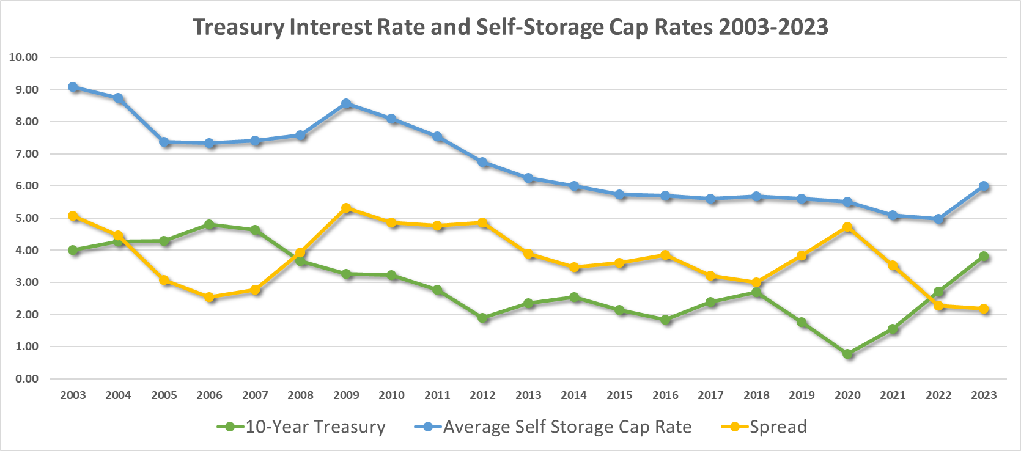
2. Capital Markets are Moving
Treasury Interest Rate and Self-Storage Cap Rates 2003-2023
Year | 2003 | 2004 | 2005 | 2006 | 2007 | 2008 | 2009 | 2010 | 2011 | 2012 | 2013 | 2014 | 2015 | 2016 | 2017 | 2018 | 2019 | 2020 | 2021 | 2022 | Q1-Q2 2023
10-Year Treasury Interest Rate | 4.01 | 4.27 | 4.29 | 4.80 | 4.63 | 3.66 | 3.26 | 3.22 | 2.78 | 1.89 | 2.35 | 2.54 | 2.14 | 1.84 | 2.40 | 2.69 | 1.77 | 0.77 | 1.56 | 2.71 | 3.81
Avg Self Storage Cap Rate | 9.08 | 8.74 | 7.37 | 7.34 | 7.41 | 7.59 | 8.57 | 8.09 | 7.54 | 6.75 | 6.25 | 6.01 | 5.74 | 5.70 | 5.60 | 5.68 | 5.60 | 5.50 | 5.1 | 4.98 | 6.00
Spread | 5.07 | 4.47 | 3.08 | 2.54 | 2.78 | 3.93 | 5.31 | 4.87 | 4.76 | 4.86 | 3.90 | 3.47 | 3.60 | 3.86 | 3.20 | 2.99 | 3.83 | 4.73 | 3.54 | 2.27 | 2.19

Slide 14
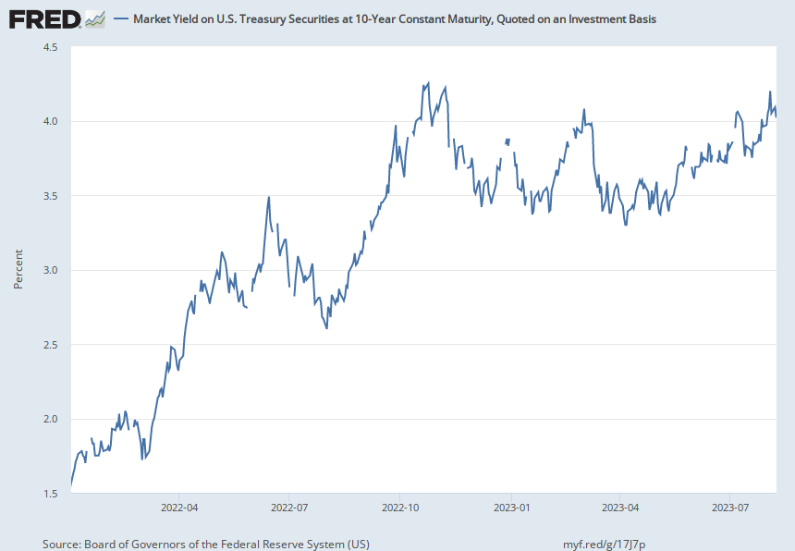
2. Capital Markets are Moving

Slide 15
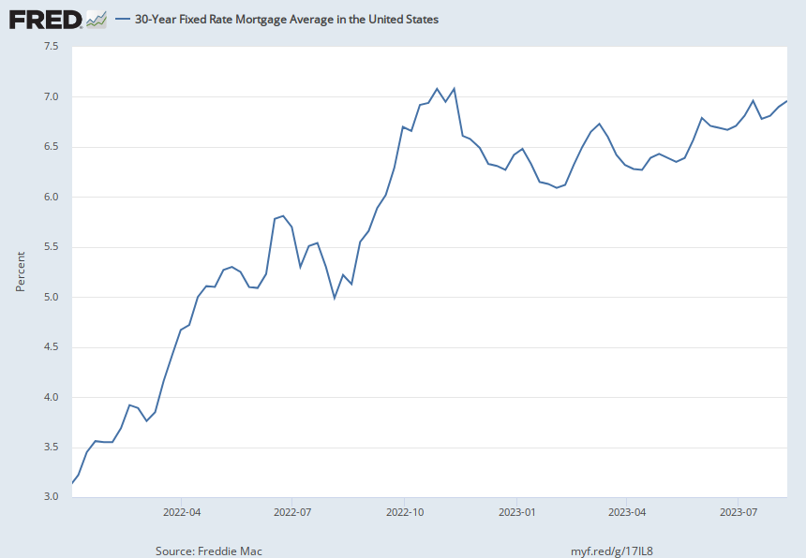
2. Capital Markets are Moving

Slide 16
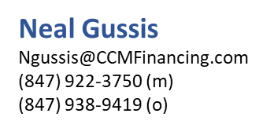
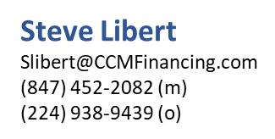

2. Capital Markets are Moving
Summary of Indices and Spreads
 | 1/1/2022 | 8/15/2022 | Increase | Permanent/Construction Spreads | Bridge Spreads | Interest Rates Today
Variable Rate (likely additional rate hikes near term)
Fed Fund Rate | 0.08% | 2.33% | 2.25%
Prime | 3.25% | 5.50% | 2.25% | -0.25 +2.0% |  | 5.25%-7.50%
BSBY – 1 month | 0.07% | 1.74% | 1.67% | 2.5%-4.0% | 3.5%+ | 4.25%-5.75%
SOFR – 1 month | 0.35% | 2.28% | 1.93% | 2.5%-4.0% | 3.5%+ | 4.75%-6.25%
LIBOR – 1 month | 0.10% | 2.38% | 2.28% | 2.5%-4.0% | 3.5%+ | 4.90%-6.40%
FHLB – 1 month | 0.31% | 2.50% | 2.19% | 1.75%-3.50% |  | 4.25%-6.00%
Fixed Rate
5 Year FHLB | 1.73% | 3.48% | 1.75% | 1.75%+2.75% |  | 5.25%-6.25%
5 Yr Treasury | 1.50% | 2.97% | 1.47% | 1.75%+3.0% |  | 4.75%-6.00%
10 Yr Treasury | 1.67% | 2.84% | 1.17% | 1.75%+3.0% |  | 4.60%-5.85%
10 Yr SOFR Swap (CMBS) | 2.74% | 2.60% | -0.14% | 2.75%+3.25% |  | 5.35%-5.85%

Slide 17
2. Capital Markets are Moving
Summary of Indices and Spreads
 | 1/1/2023 | 8/16/2023 | Increase | Permanent/Construction Spreads | Bridge Spreads | Mortgage Rates Today
Variable Rates
Fed Fund Rate | 4.25 – 4.50% | 5.25 – 5.50% | 1.00 %
WSJ Prime | 7.50% | 8.50% | 1.00% | -0.25 +2.0% |  | 8.25%-10.50%
BSBY – 1 month | 4.33% | 5.37% | 1.04% | 2.25%-4.0% | 3.50% - 5.00% | 7.60%-10.35%
SOFR – 1 month | 4.30% | 5.31% | 1.01% | 2.25%-4.0% | 3.50%- 5.00% | 7.55%-10.30%
Fixed Rates
5 Year FHLB | 4.09% | 4.64% | .55% | 1.75%+3.25% |  | 6.40%-7.90%
5 Yr Treasury | 3.84% | 4.43% | .59% | 1.75%+3.25% |  | 6.20%-7.70%
10 Yr Treasury | 3.75% | 4.21% | ,46% | 1.75%+3.25% |  | 5.95%-7.45%
10 Yr SOFR Swap (CMBS) | 3.44% | 3.92% | ,48% | 3.00%+4.00% |  | 6.90%-7.90%

Slide 18
Mid-Year Market Update
1
Market Fundamentals are Strong, but Softening
2
Capital Markets are Moving
3
Performance and Valuation have Peaked

Slide 19
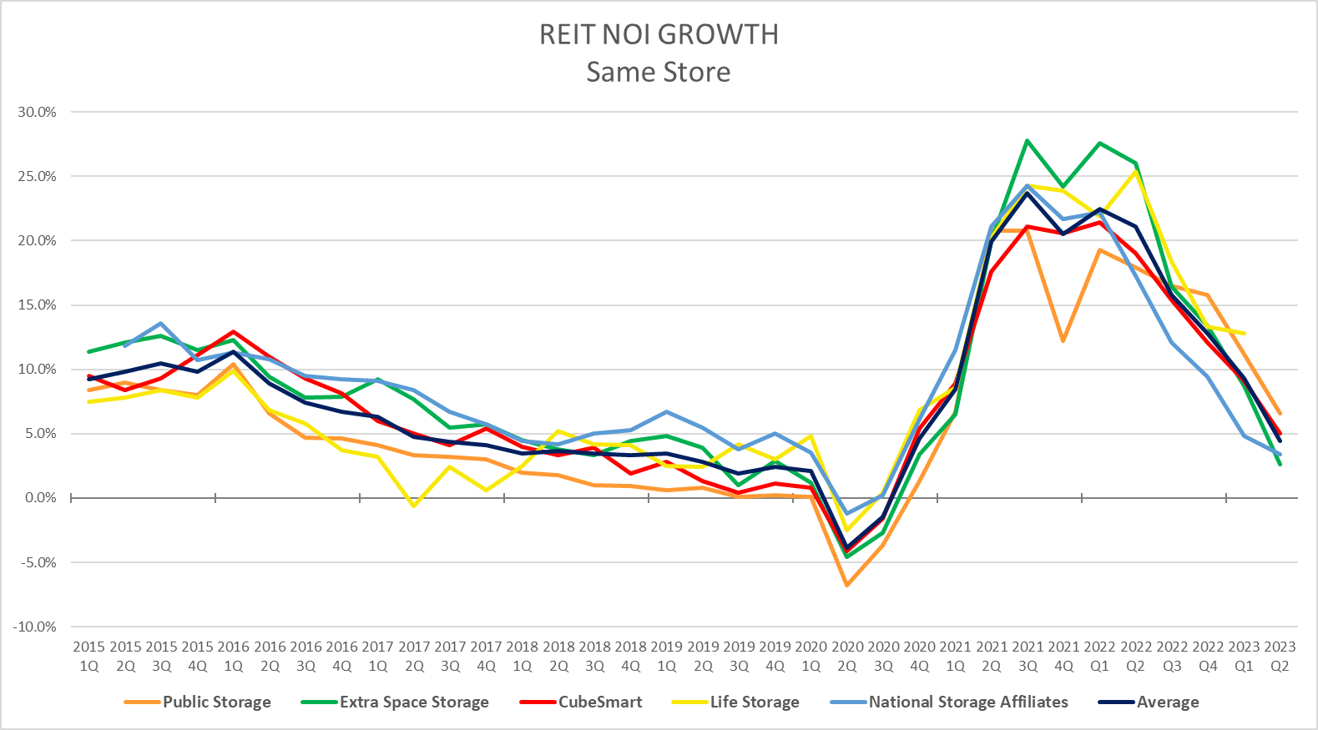
3. Performance and Valuation have Peaked
Source: Company Earnings Reports

Slide 20
3. Performance and Valuation have Peaked
Treasury Interest Rate and Self-Storage Cap Rates 2002-2022
Year | 2003 | 2004 | 2005 | 2006 | 2007 | 2008 | 2009 | 2010 | 2011 | 2012 | 2013 | 2014 | 2015 | 2016 | 2017 | 2018 | 2019 | 2020 | 2021 | 2022 | Q1-Q2 2023
10-Year Treasury Interest Rate | 4.01 | 4.27 | 4.29 | 4.80 | 4.63 | 3.66 | 3.26 | 3.22 | 2.78 | 1.89 | 2.35 | 2.54 | 2.14 | 1.84 | 2.40 | 2.69 | 1.77 | 0.77 | 1.56 | 2.71 | 3.81
Avg Self Storage Cap Rate | 9.08 | 8.74 | 7.37 | 7.34 | 7.41 | 7.59 | 8.57 | 8.09 | 7.54 | 6.75 | 6.25 | 6.01 | 5.74 | 5.70 | 5.60 | 5.68 | 5.60 | 5.50 | 5.1 | 4.98 | 6.00
Spread | 5.07 | 4.47 | 3.08 | 2.54 | 2.78 | 3.93 | 5.31 | 4.87 | 4.76 | 4.86 | 3.90 | 3.47 | 3.60 | 3.86 | 3.20 | 2.99 | 3.83 | 4.73 | 3.54 | 2.27 | 2.19

Slide 21
3. Performance and Valuation are Peaking
* Excludes $12B EXR Merger
Source: NKF Valuation & CoStar

Slide 22
3. Performance and Valuation have Peaked
Underwriting Assumptions (Stabilized)
Valuation Assumptions
Revenue Growth Years 1-2 Years 3-5 | Last Year 7%-15% 3%-6% | This Year 3%-6% 3%-6%
Occupancy Years 1-2 Years 3-5 | 90%-92% 88%-92% | Same Same
Lease Up Deals Year 1 Physical Occupancy Year 2 Physical Occupancy Year 3 Physical Occupancy | 40% 70% 90% | Same Same Same
Operating Expense Real Estate Tax Other Expense Growth Operating Expense Ratio | Post-closing adjustment 1.5%-2.5% 2.5%-3% 32%-40% Same
Stabilized Assets | T-6 or T-12 Revenue T-12 Operating Expenses
Lease Up Assets | 150-200 bps over stabilized market cap rate on Year 3 NOI
Debt Assumptions
Interest Rate | Last Year 4.75%-5.5% | This Year 6.5%-7.5%
Loan to Value | 60%-75% | 55%-65%
Amortization | 25 yr/1-2 yrs IO
Cap Rates
Class A | Last Year 3.75%-5.0% | This Year 5.25%-6%
Class B | 4.25%-6.0% | 6%-6.75%
Class C | 5.50%-7.0% | 6.75%-7.5%

Slide 23
Mid-Year Market Update
1
Market Fundamentals are Strong, but Softening
2
Capital Markets are Moving
3
Performance and Valuation have Peaked
4
The Development Wave is Slow in Coming

Slide 24
4. The Development Wave is Slow in Coming
Properties | 2018 | 2019 | 2020 | 2021 | 2022 | Argus 2023 Forecast | Argus 2024 Forecast
New Build | 619 | 578 | 577 | 575 | 487 | 470 | 432
Conversion | 132 | 145 | 97 | 108 | 82 | 80 | 62
Expansion | 446 | 261 | 139 | 175 | 171 | 184 | 118
Total | 1,197 | 984 | 813 | 858 | 740 | 779 | 647
NRSF (millions) | 2018 | 2019 | 2020 | 2021 | 2022 | Argus 2023 Forecast | Argus 2024 Forecast
New Build | 43 | 41 | 44 | 43 | 38 | 38 | 36
Conversion | 11 | 10 | 8 | 8 | 6 | 6 | 5
Expansion | 9 | 7 | 5 | 6 | 6 | 8 | 5
Total | 63 | 58 | 57 | 57 | 50 | 52 | 46
NRSF as % of Supply | 4.9% | 4.4% | 4.1% | 3.9% | 3.2% | 3.2% | 2.7%
Source: Yardi/Argus

Slide 25
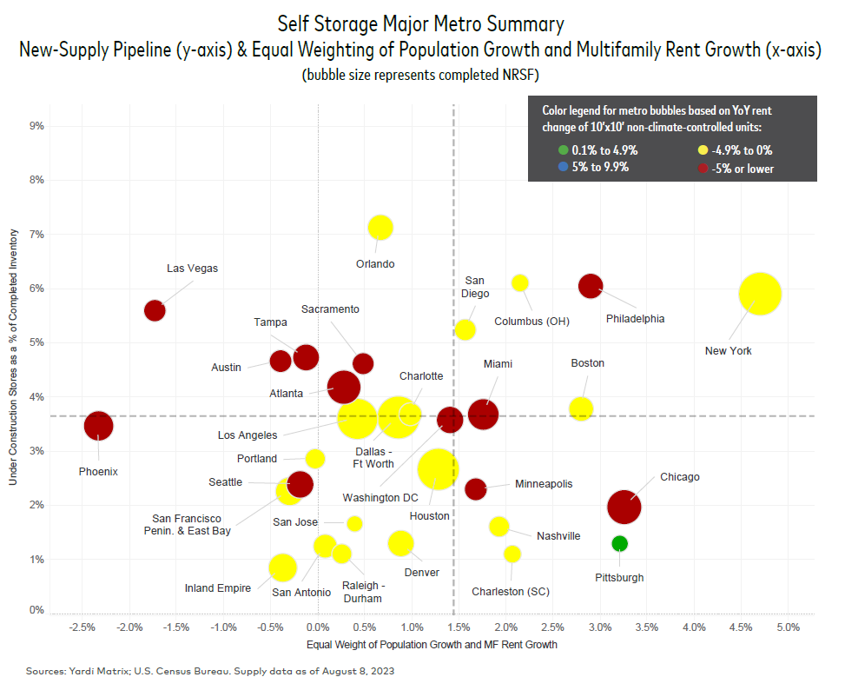
4. The Development Wave is Slow in Coming

Slide 26
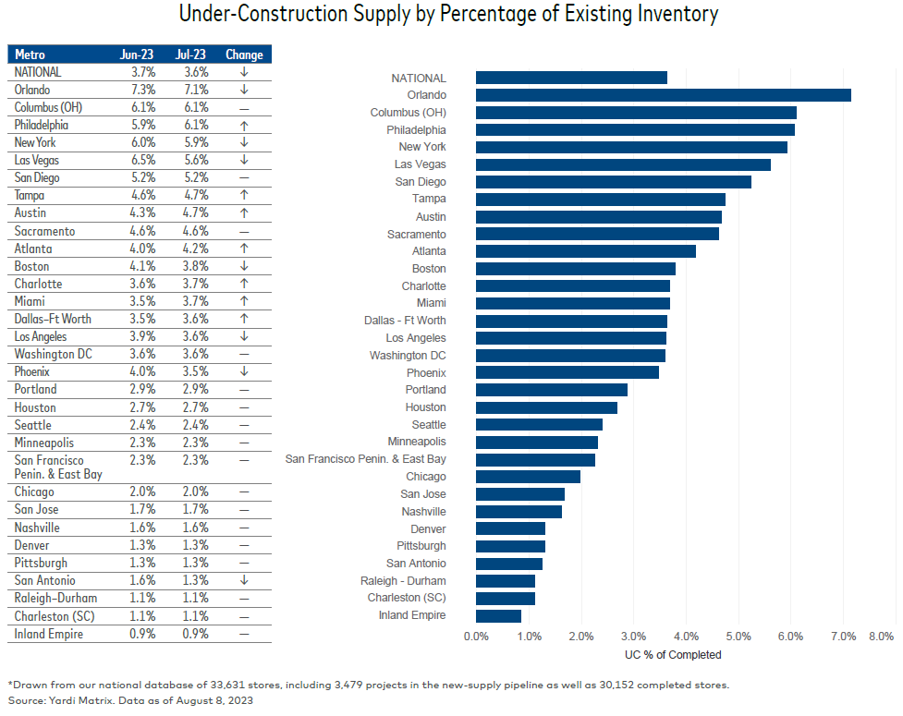
4. The Development Wave is Slow in Coming

Slide 27
Mid-Year Market Update
1
Market Fundamentals are Strong, but Softening
2
Capital Markets are Moving
3
Performance and Valuation have Peaked
4
The Development Wave is Slow in Coming
5
Understanding the Real Estate Cycle

Slide 28
5. Understanding the Real Estate Cycle
Point of maximum financial risk
“Temporary setback. I’m a long-term investor.”
“Wow, I feel great about this investment.”
Euphoria
Thrill
Anxiety
Denial
Excitement
Fear
2020
Optimism
2021
2022
Desperation
Optimism
2023
Panic
Point of maximum financial opportunity
Relief
How times have changed!
Capitulation
Hope
“Maybe the markets just aren’t for me.”
Despondency
Depression
Source: Denver Investment Advisors

Slide 29
It’s Been a Long Run

Slide 30
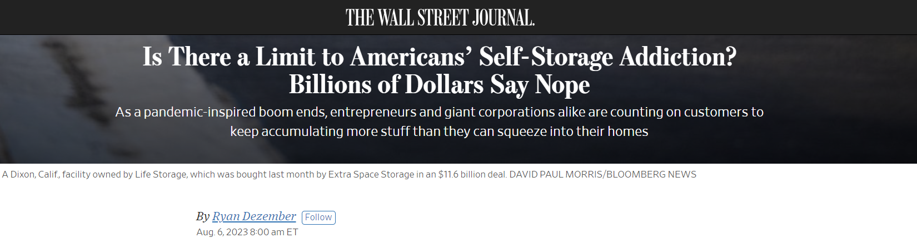
Positive Press
“The bullish case for storage is made by America’s pack-rat ways. Market researchers estimate that more than one in 10 Americans lease storage space. In June they paid an average of about $165.55 a month, down 1% from records in January, but about 20% more than in June 2019, according to a KeyBanc analysis of debit and credit card data.”

Slide 31
Market Predictions – Q4 2023/ Early 2024
1
Market Fundamentals
Self-storage NOI growth will continue, but at a slower pace as we’ve seen this past quarter – 2.5% - 5%
Physical occupancies will stabilize and start to flatten
Rental rates begin to flatten
Market fundamentals will remain strong but customer pricing fatigue will set in. ECRI will continue to flatten in 2024
Capital Markets
The lending market will be choppy and harder to navigate – rates will continue to rise slightly or flatten in Q4 2023
2

Slide 32
Market Predictions – Q4 2023/ Early 2024
3
Performance and Valuation
Cap rates for CORE major MSAs will remain low (relatively) and suburban and secondary cap rates will rise 50-150 basis points.
Major markets will outperform on a % basis!
Self-storage assets will continue to achieve CORE asset pricing – relative to the broader market
4
The Development Wave
Construction loans will become harder to get/pencil (New Development 2025)
5
Understanding the Real Estate Cycle
Transaction velocity will soften but remain active. One to five-property deals will dominate the transaction market
We will continue to see consolidation and large portfolio acquisitions or mergers.

Slide 33
Questions?
Cole Carosella
Director of Business Development
Argus Self Storage Advisors
720-909-8602
cole@argus-realestate.com
www.argus-selfstorage.com
Self Storage Advisors

